Slide 1

AGILE DESIGN
THINKING + GENAI
COURSE SLIDES · WSQ
Fast-Track Innovations with Agile Design Thinking and Generative AI (GenAI)
WSQ Course Code: TGS-2024049781
Conducted by Tertiary Infotech Academy Pte Ltd · UEN 201200696W
Version v4.0 · 17 August 2026
© 2026 Tertiary Infotech Academy Pte Ltd. All rights reserved. · www.tertiarycourses.com.sg

Slide 2
COURSE ADMINISTRATION
Welcome & Housekeeping
Fast-Track Innovations with Agile Design Thinking and GenAI · TGS-2024049781
© 2026 Tertiary Infotech Academy Pte Ltd
2

Slide 3
TRAQOM · SSG DIGITAL ATTENDANCE
Digital Attendance (Mandatory)
Three times a day
Take the AM, PM and Assessment digital attendance — mandatory for every WSQ-funded course.
Trainer shows the QR
The trainer or administrator displays the digital attendance QR code from the SSG portal.
1
2
Scan and submit
Scan the QR code with your mobile phone camera and submit your attendance.
75% minimum
A minimum of 75% attendance is required to be eligible for assessment and funding.
3
4
Fast-Track Innovations with Agile Design Thinking and GenAI · TGS-2024049781
© 2026 Tertiary Infotech Academy Pte Ltd
3

Slide 4
YOUR TRAINER · GENERAL
About the Trainer
NAME
____________________________________________
?
TITLE / DESIGNATION
____________________________________________
QUALIFICATIONS
____________________________________________
Your Trainer
AREAS OF EXPERTISE
____________________________________________
General Trainer template — to be completed by the trainer
TRAINING & INDUSTRY EXPERIENCE
____________________________________________
CONTACT
____________________________________________
Fast-Track Innovations with Agile Design Thinking and GenAI · TGS-2024049781
© 2026 Tertiary Infotech Academy Pte Ltd
4

Slide 5
YOUR TRAINER
About the Trainer
ROLE
Principal Trainer, Tertiary Infotech Academy Pte Ltd
AA
EXPERTISE
Design thinking, agile innovation, generative AI and applied data science.
Dr. Alfred Ang
DELIVERS
WSQ courses on innovation, design thinking, agile practice and generative AI.
Principal Trainer Tertiary Infotech Academy Pte Ltd
FOUNDER
Founder and lead instructor at Tertiary Infotech / Tertiary Courses.
Fast-Track Innovations with Agile Design Thinking and GenAI · TGS-2024049781
© 2026 Tertiary Infotech Academy Pte Ltd
5

Slide 6
ICE-BREAKER
Let's Know Each Other
• Your name, organisation and role.
• A product, service or process you are responsible for improving.
• Your experience with design thinking, agile or generative AI tools (if any).
• One innovation that is currently stuck — we will come back to it on Day 2.
Fast-Track Innovations with Agile Design Thinking and GenAI · TGS-2024049781
© 2026 Tertiary Infotech Academy Pte Ltd
6

Slide 7
HOUSEKEEPING
Ground Rules
Set your mobile phone to silent mode.
Participate actively — no question is too small.
1
2
Mutual respect: agree to disagree.
One conversation at a time.
3
4
Be punctual; return from breaks on time.
75% attendance is required.
5
6
Fast-Track Innovations with Agile Design Thinking and GenAI · TGS-2024049781
© 2026 Tertiary Infotech Academy Pte Ltd
7

Slide 8
LMS / TMS · lms-tms.tertiaryinfotech.com
Download Your Course Material
1 · Go to the LMS portal
Open https://lms-tms.tertiaryinfotech.com in your browser.
2 · Log in
Sign in with the account e-mail you used to register for this course.
1
2
3 · Open this course
Select 'Fast-Track Innovations with Agile Design Thinking and Generative AI (GenAI)'.
4 · Download
Download the Trainer Slides, Learner Guide and Lesson Plan (PDF).
3
4
5 · Get the activity briefs
Download the activity PDFs — each carries the case, questions and debrief.
6 · Keep them open
You may use these materials during the open-book assessment.
5
6
Fast-Track Innovations with Agile Design Thinking and GenAI · TGS-2024049781
© 2026 Tertiary Infotech Academy Pte Ltd
8

Slide 9
SKILLS FRAMEWORK · TSC
Skills Framework Alignment
TSC Title
Design Thinking Practice
TSC Code
ICT-ACE-5014-1.1
1
2
A1 / A2
Integrate design thinking into processes; develop strategies to proliferate it across the organisation.
A3 / A5
Synthesise information from stakeholders; engage them to uncover motivations and behaviours.
3
4
A4 / A6
Drive new strategies for products and services; cultivate design thinking to foster innovation.
A7 · K1–K5
Lead design thinking projects; trends, innovation management, growth drivers, resources, PM tools.
5
6
Fast-Track Innovations with Agile Design Thinking and GenAI · TGS-2024049781
© 2026 Tertiary Infotech Academy Pte Ltd
9

Slide 10
SCHEDULE · 9:30 AM – 6:30 PM
Lesson Plan — 2 Days, 8 Training Hours per Day
1
Day 1 AM — Foundations
Digital attendance · introductions · learning outcomes · Topic 1: Foundations of Design Thinking, Agile and GenAI · Activity 1.
2
Day 1 PM — Problem Framing and Ideation
Digital attendance · Activities 2 and 3 · Topic 2: framing, empathy maps, HMW and ideation · Activities 4 and 5.
3
Day 2 AM — Agile Delivery
Digital attendance · Activity 6 · Topic 3: Scrum, dual-track agile and the decomposition ladder · Activity 7.
4
Day 2 PM — Scaling and Assessment
Digital attendance · Activities 8 and 9 · Topic 4: scaling, systems thinking and metrics · Activities 10–12 · revision, TRAQOM and the assessment session.
Fast-Track Innovations with Agile Design Thinking and GenAI · TGS-2024049781
© 2026 Tertiary Infotech Academy Pte Ltd
10

Slide 11
WHAT YOU'LL ACHIEVE
Learning Outcomes
LO1 · Integrate DT + Agile + GenAI
Integrate design thinking methodologies and agile principles to drive organisational innovation using generative AI.
LO2 · Synthesise stakeholder inputs
Synthesise stakeholder inputs to uncover end-user needs for successful innovation.
1
2
LO3 · Lead design thinking projects
Lead design thinking projects using project management tools and techniques to enhance organisational performance.
LO4 · Develop agile DT strategies
Develop strategies for agile design thinking to enhance product and service innovation.
3
4
Fast-Track Innovations with Agile Design Thinking and GenAI · TGS-2024049781
© 2026 Tertiary Infotech Academy Pte Ltd
11

Slide 12
FOUR TOPICS · 12 CASE-STUDY ACTIVITIES
Course Outline
1
Topic 1 — Foundations of Design Thinking, Agile and Generative AI
Mindsets and methodologies · product development through DT and Agile · how GenAI enhances both · latest trends.
2
Topic 2 — Problem Framing and Ideation
Defining the problem · persona mapping and empathy with GenAI · ideation techniques · AI-driven prototyping.
3
Topic 3 — Agile Development and AI for Rapid Solution Delivery
Agile frameworks · converting ideas into features, stories and tasks with GenAI · faster sprints · scaling across teams.
4
Topic 4 — Scaling and Sustaining Innovations
Scaling DT and AI across the organisation · stakeholder buy-in · resource management with AI · metrics and KPIs.
Fast-Track Innovations with Agile Design Thinking and GenAI · TGS-2024049781
© 2026 Tertiary Infotech Academy Pte Ltd
12

Slide 13
ED-TOOL 1 · USED IN ACTIVITIES 4, 5, 6, 9, 11
Your Collaboration Tool — Design Thinking Studio
https://alfredang.github.io/designthinking/
The trainer clicks Create New Workspace and shares the code or QR.
1
Design Thinking Studio
A shared five-stage design thinking workspace. The whole class works in one live workspace, posting notes into the Empathize, Define, Ideate, Prototype and Test stages — including a four-quadrant Empathy Map, How Might We questions with voting, a brainstorming board with Crazy 8s, and a full prototype and test plan section.
Click Join Workspace, enter the code, then enter your display name.
2
Use the stage stepper to move through Empathize → Define → Ideate → Prototype → Test.
3
Click Add note in any section — give it a Title, Description and optional Category.
4
Fast-Track Innovations with Agile Design Thinking and GenAI · TGS-2024049781
© 2026 Tertiary Infotech Academy Pte Ltd
13

Slide 14
ED-TOOL 2 · USED IN ACTIVITIES 1, 2, 3, 7, 8, 10, 12
Your Classroom Board — Padlet
https://alfredang.github.io/padlet/
The trainer creates a classroom and shares the classroom code.
1
Padlet Classroom Board
An online classroom board for posting group output, comparing it across groups, and voting. Posts can carry text, images, links, YouTube videos or PDFs, and can be liked and commented on. The board is organised into sections and sub-sections, and can be sorted by newest, oldest or most liked so the strongest thinking rises to the top.
Join the classroom and enter your display name.
2
Use + to Add post into the section for the current activity.
3
Like the strongest posts from other groups and comment on their reasoning.
4
Fast-Track Innovations with Agile Design Thinking and GenAI · TGS-2024049781
© 2026 Tertiary Infotech Academy Pte Ltd
14

Slide 15
BEFORE YOU START
Briefing for Assessment
Do · Clear your desk
Place phones and other materials under the table or on the floor.
Don't · No recording
No photos or recording of assessment scripts.
1
2
Don't · No discussion
Work individually — no discussion during the assessment.
Do · Black or blue pen
Use a black or blue pen for hard-copy assessments.
3
4
Don't · No correction fluid
No liquid paper or correction tape may be used.
Do · Stop on time
Scripts are collected when time is up.
5
6
Fast-Track Innovations with Agile Design Thinking and GenAI · TGS-2024049781
© 2026 Tertiary Infotech Academy Pte Ltd
15

Slide 16
FINAL ASSESSMENT
Assessment
Written Assessment (WA)
Short-Answer Questions (SAQ) · 0.5 hour · open book. Tests the underpinning knowledge taught in the slides.
Case Study (CS)
A scenario-based innovation case · 1 hour · open book. Tests applied judgement across all four topics.
1
2
Open book
You may use the course slides, the Learner Guide, your activity briefs and approved materials only.
Eligibility
A minimum of 75% attendance is required to be eligible for assessment and funding.
3
4
Result
You are assessed as Competent (C) or Not Yet Competent (NYC) on each instrument.
Appeals
An appeal process is available if you wish to contest an assessment outcome.
5
6
Fast-Track Innovations with Agile Design Thinking and GenAI · TGS-2024049781
© 2026 Tertiary Infotech Academy Pte Ltd
16

Slide 17
ON ASSESSMENT DAY
Assessment Flow
1
2
3
4
5
TRAQOM survey
Digital attendance
Sit WA then CS
Submit on the LMS
Sign the record
Scan the QR code on the LMS
Scan the SSG assessment QR
WA 0.5 h then CS 1 h · open book
Upload your completed answers
Sign the Assessment Summary Record
REMEMBER
All five steps are mandatory for WSQ funding — missing the digital attendance or the TRAQOM survey can invalidate your claim.
Fast-Track Innovations with Agile Design Thinking and GenAI · TGS-2024049781
© 2026 Tertiary Infotech Academy Pte Ltd
17

Slide 18
WSQ FUNDING
Criteria for Funding
Attendance
A minimum attendance rate of 75%, based on the SSG Digital Attendance record.
Assessment
Complete both assessment components and be assessed as 'Competent'.
1
2
Digital attendance
Scan the SSG QR code for AM, PM and Assessment on every training day.
TRAQOM survey
Complete the mandatory TRAQOM course feedback survey on the LMS.
3
4
Fast-Track Innovations with Agile Design Thinking and GenAI · TGS-2024049781
© 2026 Tertiary Infotech Academy Pte Ltd
18

Slide 19
01
TOPIC 01
Foundations of Design Thinking, Agile, and Generative AI for Problem-Solving
Design Thinking · Lean · Agile · Generative AI · The innovation operating system
Fast-Track Innovations with Agile Design Thinking and GenAI · TGS-2024049781
© 2026 Tertiary Infotech Academy Pte Ltd
19

Slide 20
TOPIC 01 · WHY THIS MATTERS
Your first idea is almost never your best idea.
Design Thinking is the discipline of resisting the first plausible answer long enough to find a better one.
Fast-Track Innovations with Agile Design Thinking and GenAI · TGS-2024049781
© 2026 Tertiary Infotech Academy Pte Ltd
20

Slide 21
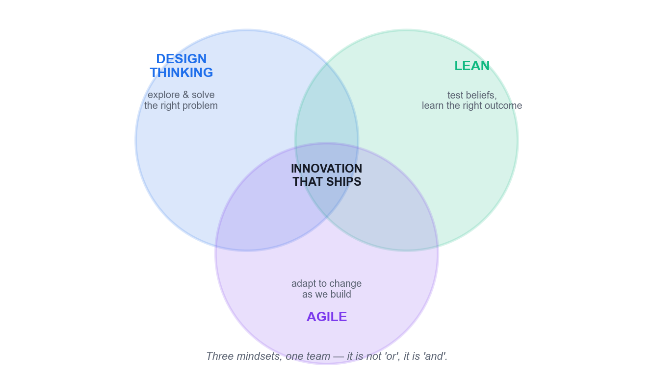
DESIGN THINKING · LEAN · AGILE
The Three Mindsets of Innovation
Design Thinking = explore and solve the RIGHT PROBLEM · Lean = test beliefs to find the RIGHT OUTCOME · Agile = adapt to change and BUILD IT RIGHT.
Fast-Track Innovations with Agile Design Thinking and GenAI · TGS-2024049781
© 2026 Tertiary Infotech Academy Pte Ltd
21

Slide 22
THE COMPARISON THAT ANCHORS THE COURSE
Design Thinking vs Lean vs Agile
Design Thinking
Lean Startup
Agile
Primary focus
Understanding users deeply
Validating ideas efficiently
Iterative delivery and adaptation
The question it answers
How should we think about this problem?
How do we validate this solution efficiently?
How do we build, scale and improve it?
Origin
Human-centred design practice
Toyota lean manufacturing
A counterpoint to Waterfall
Core move
Reframe the problem through empathy
Build an MVP, let the customer decide value
Ship increments in short sprints
Timeframe
Flexible — one day to one month
Rapid, minimal validation cycles
Sprint-based, continuous
Fails when
It never reaches delivery
It validates a problem nobody has
It builds the wrong thing efficiently
WHEN IT MATTERS It is not 'Lean or Agile?' — it is 'and'. All three are mindsets, not processes.
Fast-Track Innovations with Agile Design Thinking and GenAI · TGS-2024049781
© 2026 Tertiary Infotech Academy Pte Ltd
22

Slide 23
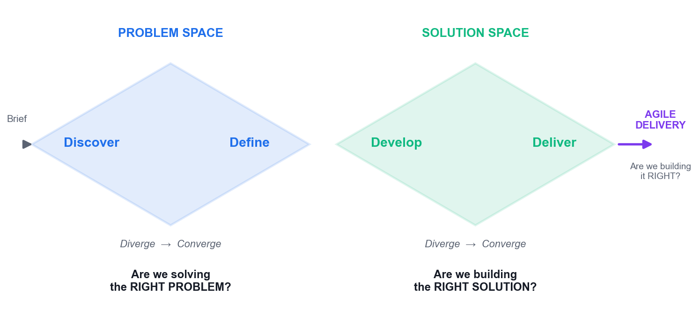
THE CORE DIAGRAM OF THE COURSE
The Double Diamond
Diamond 1 · Problem space
Diverge to understand the user, then converge on a clear problem statement.
Diamond 2 · Solution space
Diverge to generate many solutions, then converge on the one worth building.
Then Agile delivers
Sprints answer the third question: building it right?
The discipline
Never converge before you diverge. The first diamond is the one teams skip.
Fast-Track Innovations with Agile Design Thinking and GenAI · TGS-2024049781
© 2026 Tertiary Infotech Academy Pte Ltd
23

Slide 24
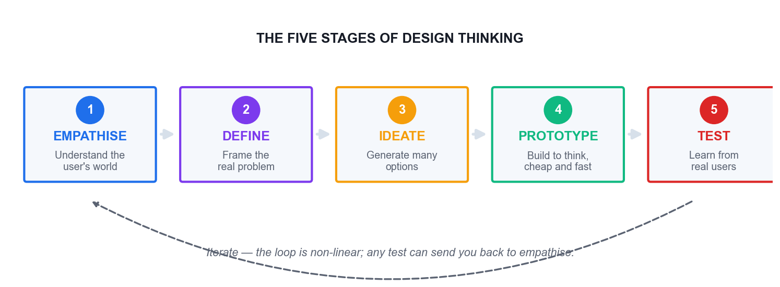
EMPATHISE · DEFINE · IDEATE · PROTOTYPE · TEST
The Five Stages of Design Thinking
The stages overlap and repeat continuously — this is a loop you re-enter, not a waterfall you complete once.
Fast-Track Innovations with Agile Design Thinking and GenAI · TGS-2024049781
© 2026 Tertiary Infotech Academy Pte Ltd
24

Slide 25
DEFINITION
What Design Thinking Actually Is
A solution-based approach
It tackles problems that are ill-defined or unknown by understanding the human needs involved.
Human-centred reframing
It re-frames the problem in human terms before any solution is proposed.
1
2
Volume then judgement
It creates many ideas in structured ideation, then converges deliberately.
Hands-on by default
It adopts a build-to-think approach through prototyping and testing with real users.
3
4
Fast-Track Innovations with Agile Design Thinking and GenAI · TGS-2024049781
© 2026 Tertiary Infotech Academy Pte Ltd
25

Slide 26
CARISSA CARTER · STANFORD d.school
The Abilities That Make a Designer
Dealing with ambiguity
Staying productive when the problem itself is still unclear — the defining skill of the discipline.
Empathetic learning
Understanding a user's world from inside their experience, not from a survey summary.
1
2
Synthesis
Turning a mass of qualitative evidence into a small number of insights you can design against.
Experimentation
Treating every belief as testable, and designing the cheapest test that could disprove it.
3
4
Fast-Track Innovations with Agile Design Thinking and GenAI · TGS-2024049781
© 2026 Tertiary Infotech Academy Pte Ltd
26

Slide 27
RITTEL & WEBBER, 1973
Wicked Problems — Why Framing Comes First
Coined in 1973
Horst Rittel and Melvin Webber, UC Berkeley professors of design and urban planning.
Hard to even define
Abstract challenges with multiple interconnected layers — poverty, climate change, public health.
1
2
No single right answer
They have no fixed endpoint and no single correct solution, only better and worse responses.
Tame problems differ
A tame problem has a knowable answer; reaching for a tame method on a wicked problem is the classic error.
3
4
Fast-Track Innovations with Agile Design Thinking and GenAI · TGS-2024049781
© 2026 Tertiary Infotech Academy Pte Ltd
27

Slide 28
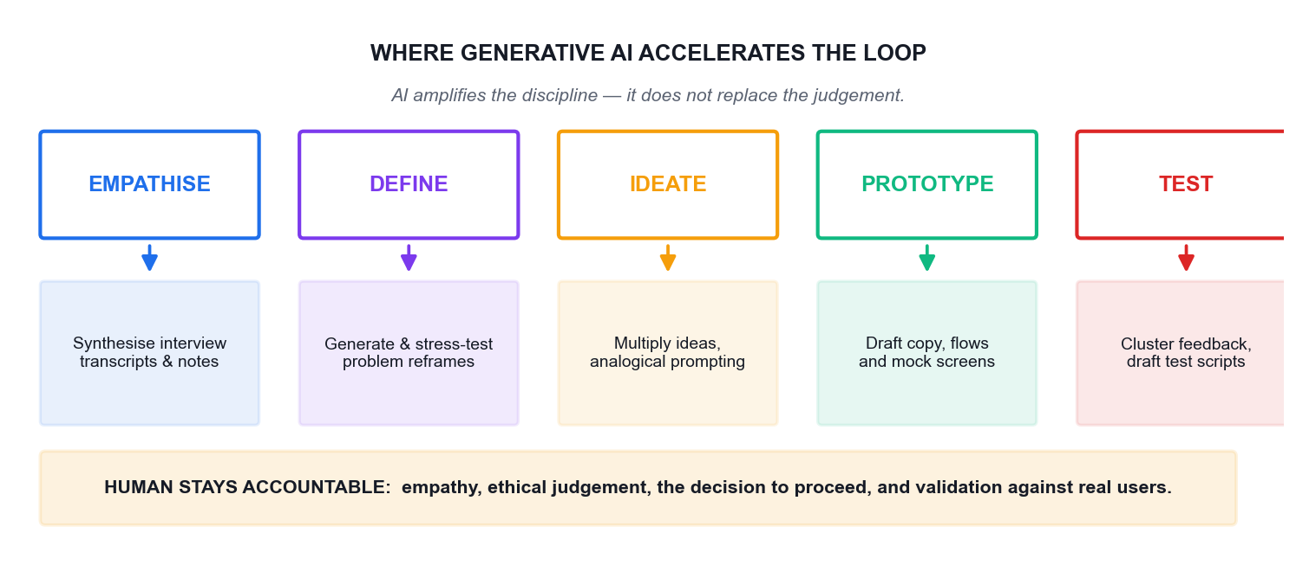
THE GENAI OVERLAY
Where Generative AI Accelerates the Loop
AI acts as an amplifier of good design thinking discipline — never a substitute for it.
Fast-Track Innovations with Agile Design Thinking and GenAI · TGS-2024049781
© 2026 Tertiary Infotech Academy Pte Ltd
28

Slide 29
THE PRACTICAL DIVISION OF LABOUR
What GenAI Does Well — and Where It Fails
Stage
GenAI genuinely accelerates
What must stay human
Empathise
Synthesising interview transcripts and field notes at speed
Being in the room; noticing what is not said
Define
Generating and stress-testing candidate reframes
Choosing which problem the organisation will own
Ideate
Multiplying idea volume and range on demand
Recognising the idea that fits this context
Prototype
Drafting copy, flows, screens and edge cases
Deciding what is cheap enough to learn from
Test
Clustering feedback and drafting scripts
Watching a real user hesitate, and asking why
WHEN IT MATTERS A language model produces the statistically likely, not the locally true. Use it to diverge; validate before you converge.
Fast-Track Innovations with Agile Design Thinking and GenAI · TGS-2024049781
© 2026 Tertiary Infotech Academy Pte Ltd
29

Slide 30
WHERE THE PRACTICE IS GOING
Latest Trends in Innovation
AI-assisted discovery
Research synthesis that took a team weeks now takes hours — the bottleneck moves to judgement.
Continuous discovery
Discovery is no longer a phase before delivery; it runs permanently alongside it.
1
2
Cross-functional trios
A product manager, designer and engineer own discovery together rather than passing artefacts.
Evidence over opinion
Decisions increasingly demand a named assumption and the test that would disprove it.
3
4
Responsible AI
Provenance, bias and governance become part of the innovation process, not a legal afterthought.
Outcome over output
Organisations shift from counting features shipped to measuring the customer value created.
5
6
Fast-Track Innovations with Agile Design Thinking and GenAI · TGS-2024049781
© 2026 Tertiary Infotech Academy Pte Ltd
30

Slide 31
TOPIC 01 · REAL-WORLD CASE STUDY
Airbnb — Diagnosing Why a Method Alone Does Not Save a Business
ACTIVITY 1 · 45 MIN
THE REAL CASE
YOUR SCENARIO
Airbnb, 2009. The company was weeks from failing, stuck at roughly $200 revenue a week. The founders noticed a pattern in the New York listings: the photographs were terrible, taken on cheap phone cameras in bad light. Rather than run an A/B test or ship a feature, Paul Graham told them to fly to New York and meet the hosts. They rented a camera, went door to door, and replaced the amateur photos with professional ones. Within a week revenue roughly doubled. It was not a scalable act and it was not in any sprint backlog — but it was the insight that unlocked the business, and it later became a funded, scaled service.
Your team is the innovation unit of a regional marketplace platform whose bookings have flatlined. Analytics show visitors browse and leave. The engineering team wants to A/B test the checkout button. You suspect, as Airbnb did, that the real problem is not on the screen at all.
Full case, discussion questions and debrief: see the Learner Guide and the printed activity brief.
Fast-Track Innovations with Agile Design Thinking and GenAI · TGS-2024049781
© 2026 Tertiary Infotech Academy Pte Ltd
31

Slide 32
ACTIVITY 1 · WORK IN GROUPS OF 3–5
45 MIN
Activity 1 — Discussion Questions
1
Which of the three disciplines — Design Thinking, Lean or Agile — actually produced the photography insight, and why could the other two not have produced it?
2
The founders did something deliberately unscalable. When is 'do things that don't scale' the right innovation strategy, and when is it an excuse to avoid rigour?
3
Map the story onto the Double Diamond. Where does 'fly to New York and meet the hosts' sit — Discover, Define, Develop or Deliver?
4
Your engineers want to A/B test the checkout button. Write the one question you would ask them to expose whether they are solving the right problem.
5
How would you have used GenAI here — and what part of this story could GenAI NOT have done for you?
Fast-Track Innovations with Agile Design Thinking and GenAI · TGS-2024049781
© 2026 Tertiary Infotech Academy Pte Ltd
32

Slide 33
ACTIVITY 1 · BRIEF
Activity 1 — What You Produce
1
Your task
Learners analyse the Airbnb turnaround to separate the three disciplines — Design Thinking (finding the right problem), Lean (validating the solution is worth building) and Agile (building it right) — and explain why starting with Agile alone would never have surfaced the photography insight.
2
You will produce
A completed Padlet board mapping the Airbnb story onto Design Thinking / Lean / Agile, plus a group position statement on what the marketplace platform should do first.
3
Tools
Padlet Classroom Board, ChatGPT or Microsoft Copilot
4
Done when
Your board shows the story correctly split across all three disciplines, and your recommendation names a discovery action before any build action.
Fast-Track Innovations with Agile Design Thinking and GenAI · TGS-2024049781
© 2026 Tertiary Infotech Academy Pte Ltd
33

Slide 34
ACTIVITY 1 · TRAINER DEBRIEF
Activity 1 — Debrief
WHAT THE ROOM SHOULD CONCLUDE
The photography insight came from Empathise, not from analytics. Agile would have optimised the wrong thing faster — a better checkout button on a listing nobody wanted to book. Lean's contribution was the cheap validation (a handful of listings, one week, one rented camera) before any engineering investment. The trap the class should name out loud: teams reach for Agile because it feels productive, and end up building the wrong thing right. GenAI could have clustered the review complaints and drafted interview guides in minutes, but it could not have sat in a host's living room and noticed the light. Empathy is still human work; AI compresses the analysis around it.
Fast-Track Innovations with Agile Design Thinking and GenAI · TGS-2024049781
© 2026 Tertiary Infotech Academy Pte Ltd
34

Slide 35
TOPIC 01 · REAL-WORLD CASE STUDY
Netflix vs Blockbuster — Innovation as an Operating System
ACTIVITY 2 · 45 MIN
THE REAL CASE
YOUR SCENARIO
In 2000 Reed Hastings offered to sell Netflix to Blockbuster for $50 million. Blockbuster's CEO reportedly laughed him out of the room. Blockbuster had 9,000 stores and made a large share of its profit from late fees — a revenue stream that depended on customers being unhappy. Netflix removed late fees entirely, then cannibalised its own profitable DVD-by-mail business to launch streaming in 2007, then cannibalised licensed content by producing originals from 2013. Blockbuster filed for bankruptcy in 2010. Netflix did not win on a single idea; it won because it repeatedly ran the innovation loop against itself while its competitor optimised the business it already had.
You lead innovation at an established Singapore firm whose most profitable product line depends on a customer inconvenience — a booking fee, a lock-in contract, or a manual process customers pay to have done for them. A start-up has just launched a free alternative. The board wants a response by the end of the quarter.
Full case, discussion questions and debrief: see the Learner Guide and the printed activity brief.
Fast-Track Innovations with Agile Design Thinking and GenAI · TGS-2024049781
© 2026 Tertiary Infotech Academy Pte Ltd
35

Slide 36
ACTIVITY 2 · WORK IN GROUPS OF 3–5
45 MIN
Activity 2 — Discussion Questions
1
Blockbuster's late fees were both its profit engine and its biggest customer pain point. What is the equivalent in your own organisation?
2
Netflix cannibalised two of its own successful businesses. What made that organisationally possible, and what would block it where you work?
3
'Measure things that matter' — what was Blockbuster measuring that made the decision to decline look rational at the time?
4
Was Blockbuster's failure a failure of ideas, of execution, or of the operating system around both? Defend your answer.
5
Where could GenAI have given Blockbuster early warning, and would leadership have believed it?
Fast-Track Innovations with Agile Design Thinking and GenAI · TGS-2024049781
© 2026 Tertiary Infotech Academy Pte Ltd
36

Slide 37
ACTIVITY 2 · BRIEF
Activity 2 — What You Produce
1
Your task
Learners contrast an organisation that treated innovation as a repeatable operating system with one that optimised its existing model, and identify the specific organisational conditions — purpose, autonomy, and what gets measured — that allowed one to self-disrupt and prevented the other.
2
You will produce
A Padlet comparison board plus a written 'what we would have to stop measuring' statement for the learner's own organisation.
3
Tools
Padlet Classroom Board, ChatGPT or Microsoft Copilot
4
Done when
Your board names at least one real metric in your own organisation that discourages innovation, and one concrete change to it.
Fast-Track Innovations with Agile Design Thinking and GenAI · TGS-2024049781
© 2026 Tertiary Infotech Academy Pte Ltd
37

Slide 38
ACTIVITY 2 · TRAINER DEBRIEF
Activity 2 — Debrief
WHAT THE ROOM SHOULD CONCLUDE
Blockbuster did not lack information — it lacked an operating system that let unwelcome information change a decision. Its metrics rewarded protecting late-fee revenue, so every rational manager defended it. This is the 'measure things that matter' principle in its negative form: a metric that cannot change a decision is decoration, and a metric that punishes the future protects the past. Netflix's advantage was structural, not creative: purpose and autonomy at the top, cheap experiments underneath, and a willingness to let a new bet eat an old one. GenAI would have flagged the trend, but the barrier was never detection — it was the incentive to act.
Fast-Track Innovations with Agile Design Thinking and GenAI · TGS-2024049781
© 2026 Tertiary Infotech Academy Pte Ltd
38

Slide 39
TOPIC 01 · REAL-WORLD CASE STUDY
Positioning GenAI in the Innovation Loop — Where It Helps and Where It Lies
ACTIVITY 3 · 40 MIN
THE REAL CASE
YOUR SCENARIO
A Singapore bank's innovation team used a large language model to generate customer personas for a new savings product aimed at gig-economy workers. The AI produced five polished, confident personas in under a minute, complete with names, incomes, quotes and frustrations. The team built a concept around 'Marcus, 29, a Grab driver saving for a HDB flat'. When they finally ran six real interviews, the actual gig workers' dominant anxiety was not saving for a flat at all — it was irregular income smoothing within a single month, and a deep distrust of anything that locked their money away. The AI personas were plausible, internally consistent, well-written, and wrong. They were a compression of what the internet says about gig workers, not evidence about these gig workers.
Your team has two weeks to produce a validated problem statement. A colleague proposes skipping the interviews because 'the AI personas are good enough and we're behind schedule'.
Full case, discussion questions and debrief: see the Learner Guide and the printed activity brief.
Fast-Track Innovations with Agile Design Thinking and GenAI · TGS-2024049781
© 2026 Tertiary Infotech Academy Pte Ltd
39

Slide 40
ACTIVITY 3 · WORK IN GROUPS OF 3–5
40 MIN
Activity 3 — Discussion Questions
1
The AI personas were plausible but wrong. What property of large language models makes fluent output a poor proxy for truth?
2
Which parts of the design thinking loop can GenAI genuinely accelerate, and which parts must stay human? Draw the line and justify it.
3
Your colleague says the interviews can be skipped. Give the strongest version of their argument, then rebut it.
4
How would you make an AI-generated persona falsifiable — what evidence would prove it wrong?
5
What governance would you put in place so AI-generated insight is always labelled as unvalidated?
Fast-Track Innovations with Agile Design Thinking and GenAI · TGS-2024049781
© 2026 Tertiary Infotech Academy Pte Ltd
40

Slide 41
ACTIVITY 3 · BRIEF
Activity 3 — What You Produce
1
Your task
Learners run the same persona-generation task through a GenAI tool, then interrogate the output against an evidence test, to build a working rule for where GenAI belongs in the design thinking loop and where its confident fluency becomes a liability.
2
You will produce
A GenAI-generated persona set annotated with evidence gaps, and a group 'AI use rule' posted to Padlet.
3
Tools
ChatGPT or Microsoft Copilot, Padlet Classroom Board
4
Done when
Your annotated persona set clearly separates assumption from evidence, and your posted rule states both where GenAI is allowed and where it is not.
Fast-Track Innovations with Agile Design Thinking and GenAI · TGS-2024049781
© 2026 Tertiary Infotech Academy Pte Ltd
41

Slide 42
ACTIVITY 3 · TRAINER DEBRIEF
Activity 3 — Debrief
WHAT THE ROOM SHOULD CONCLUDE
A language model generates the statistically likely, not the locally true. That is exactly what you want for divergence — volume, range, provocations, first drafts — and exactly what you must not trust for convergence, where a wrong-but-confident persona sends a whole quarter's work in the wrong direction. The workable rule most groups arrive at: use GenAI to widen the funnel and to synthesise evidence you already collected; never use it as the evidence itself. Practically, every AI-generated artefact should carry a provenance label — who or what produced it, and what real-world evidence has since confirmed or refuted it. Note also the failure was caught only because someone eventually talked to six real people; six interviews is a small price for not building the wrong product.
Fast-Track Innovations with Agile Design Thinking and GenAI · TGS-2024049781
© 2026 Tertiary Infotech Academy Pte Ltd
42

Slide 43
TOPIC RECAP
Recap — Topic 1
• Design Thinking finds the right problem; Lean validates the right solution; Agile builds it right.
• The Double Diamond alternates divergence and convergence across the problem and solution spaces.
• The five stages are a loop you re-enter, not a sequence you complete.
• Wicked problems have no single correct answer — which is exactly why framing precedes solving.
• GenAI compresses synthesis and multiplies ideas, but empathy and judgement remain human work.
Fast-Track Innovations with Agile Design Thinking and GenAI · TGS-2024049781
© 2026 Tertiary Infotech Academy Pte Ltd
43

Slide 44
Lunch Break
1 hour

Slide 45
02
TOPIC 02
Problem Framing and Ideation: Leveraging Design Thinking and Generative AI
Framing · Personas · Empathy maps · HMW · Ideation · Rapid prototyping
Fast-Track Innovations with Agile Design Thinking and GenAI · TGS-2024049781
© 2026 Tertiary Infotech Academy Pte Ltd
45

Slide 46
TOPIC 02 · WHY THIS MATTERS
A problem well framed is a problem half solved.
The reframe is the highest-leverage move in design thinking — and the first thing teams skip under deadline pressure.
Fast-Track Innovations with Agile Design Thinking and GenAI · TGS-2024049781
© 2026 Tertiary Infotech Academy Pte Ltd
46

Slide 47
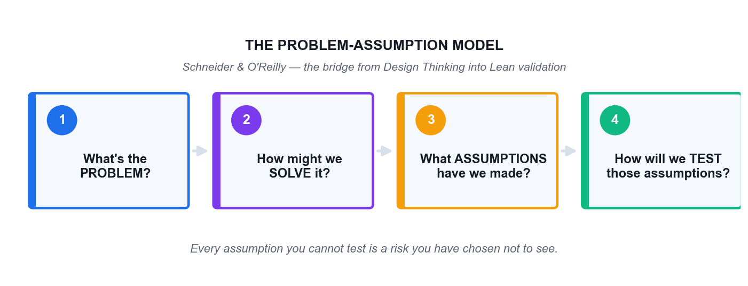
SCHNEIDER & O'REILLY
The Problem-Assumption Model
The bridge from Design Thinking into Lean validation — four questions that turn a belief into a test.
Fast-Track Innovations with Agile Design Thinking and GenAI · TGS-2024049781
© 2026 Tertiary Infotech Academy Pte Ltd
47

Slide 48
SIX STEPS TO A DESIGN CHALLENGE
Framing the Design Challenge
1 · Write the challenge
One short, memorable sentence stating the problem you want to solve.
2 · Make it a question
Convert it into a 'How Might We' question that invites many answers.
1
2
3 · Define the impact
State the change you want to see if you succeed.
4 · Explore solutions
Sketch possible directions — without committing to any of them yet.
3
4
5 · Name the constraints
Write the context and constraints that surround the question.
6 · Revisit the question
Expect to rewrite the HMW as you learn — the first version is rarely right.
5
6
Fast-Track Innovations with Agile Design Thinking and GenAI · TGS-2024049781
© 2026 Tertiary Infotech Academy Pte Ltd
48

Slide 49
THE ALTITUDE TEST
Is Your 'How Might We' at the Right Altitude?
YES — it is too NARROW
Read your HMW question aloud. Can you immediately name only ONE obvious solution?
The solution is hiding inside the question. Widen it: ask what the user is really trying to achieve.
NO — can you name ANY concrete answer?
If you cannot picture a single concrete answer, it is too BROAD. Narrow it to a specific user in a specific moment.
A workable HMW invites many different answers, and you can imagine testing each one.
Fast-Track Innovations with Agile Design Thinking and GenAI · TGS-2024049781
© 2026 Tertiary Infotech Academy Pte Ltd
49

Slide 50
THREE ARTEFACTS, THREE JOBS
Problem Statement vs Point of View vs How Might We
What it is
Example
Problem statement
A neutral description of what is wrong
Elderly patients miss their screening appointments.
Point of View (POV)
[User] needs [need] because [insight]
Mdm Tan needs to feel safe asking questions because she fears being judged for not understanding.
How Might We (HMW)
An invitation to generate solutions
How might we make a first screening feel safe rather than exposing?
The failure mode
Jumping straight to a solution disguised as a problem
'We need an SMS reminder system.' — that is an answer, not a problem.
WHEN IT MATTERS The POV is where research becomes designable. Skip it and the HMW floats free of evidence.
Fast-Track Innovations with Agile Design Thinking and GenAI · TGS-2024049781
© 2026 Tertiary Infotech Academy Pte Ltd
50

Slide 51
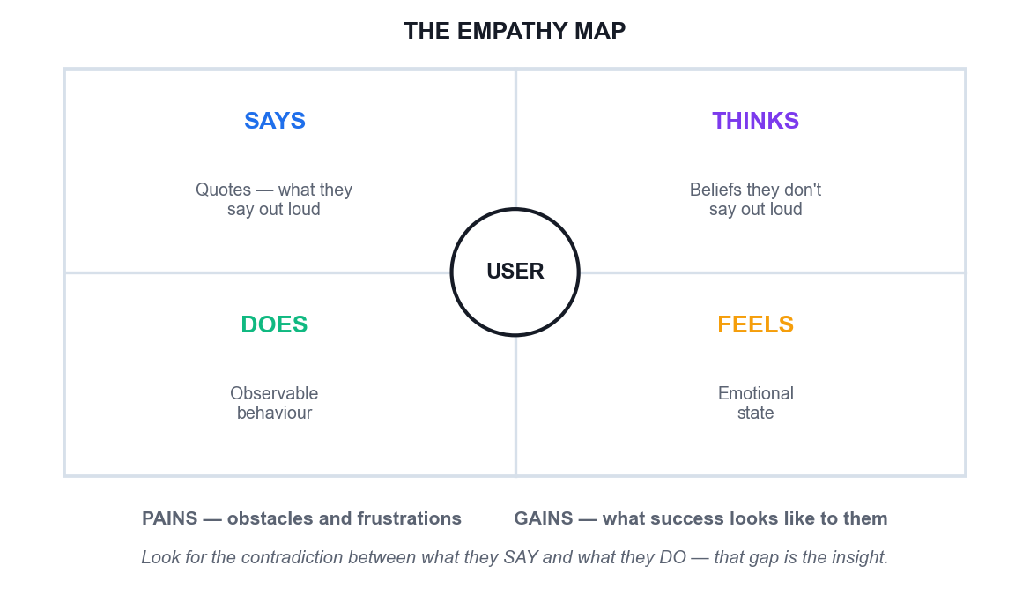
EMPATHISE · THE CORE TOOL
The Empathy Map
Says and Does are observable
You can watch and record these directly — evidence.
Thinks and Feels are inferred
You are interpreting — label as inference, not fact.
Pains and Gains at the base
Obstacles faced, and what success looks like to them.
Look for the contradiction
The gap between what users say and do is where the insight lives.
Fast-Track Innovations with Agile Design Thinking and GenAI · TGS-2024049781
© 2026 Tertiary Infotech Academy Pte Ltd
51

Slide 52
PERSONA MAPPING
Building Useful Personas
Start with 3–5
Enough to show meaningful variation, few enough to hold in the team's head.
Ground every claim
Each goal, pain and behaviour should trace to something a real person said or did.
1
2
Include the awkward one
The user who does not fit the happy path is usually where the design breaks.
Keep them comparable
Consistent layout and one shared metric across personas so you can compare them.
3
4
Label AI-generated content
An AI persona is a hypothesis. Mark it as unvalidated until evidence confirms it.
Retire them honestly
A persona contradicted by evidence must be changed, not defended.
5
6
Fast-Track Innovations with Agile Design Thinking and GenAI · TGS-2024049781
© 2026 Tertiary Infotech Academy Pte Ltd
52

Slide 53
DIVERGE BEFORE YOU CONVERGE
Ideation Techniques
Brainstorming
Group generation under explicit rules: defer judgement, go for volume, build on others' ideas.
Brainwriting
Silent written generation first — it prevents the loudest voice from anchoring the room.
1
2
Crazy 8s
Eight rapid variations in eight minutes; speed defeats the internal critic.
Worst Possible Idea
Deliberately generate terrible ideas to break the fear of contributing.
3
4
SCAMPER
Substitute, Combine, Adapt, Modify, Put to another use, Eliminate, Reverse.
AI amplification
Generate manually first, then use GenAI to extend — never the reverse, or it anchors the room.
5
6
Fast-Track Innovations with Agile Design Thinking and GenAI · TGS-2024049781
© 2026 Tertiary Infotech Academy Pte Ltd
53

Slide 54
THE ONE RULE OF IDEATION
Separate the generation of ideas from the evaluation of ideas.
Judging while generating kills the unusual ideas first — and the unusual idea is the one you came for.
Fast-Track Innovations with Agile Design Thinking and GenAI · TGS-2024049781
© 2026 Tertiary Infotech Academy Pte Ltd
54

Slide 55
PROTOTYPE · TEST
Prototyping — Build to Think
Buy information cheaply
A prototype's job is to purchase learning at the lowest possible price.
Low fidelity invites honesty
A rough sketch gets real objections; a polished mockup gets polite notes on the font.
1
2
Wizard of Oz
Fake the mechanism with a human behind the curtain — learn the behaviour before building anything.
Storyboard the experience
Draw the scenario as a strip so the team can role-play and feel where it breaks.
3
4
Write the falsification test
State in advance what result would prove the concept wrong — or it is a demo, not a test.
GenAI drafts the content
Screen copy, flows, edge cases and interview scripts in minutes — you still run the test.
5
6
Fast-Track Innovations with Agile Design Thinking and GenAI · TGS-2024049781
© 2026 Tertiary Infotech Academy Pte Ltd
55

Slide 56
TOPIC 02 · REAL-WORLD CASE STUDY
GE Adventure Series — Reframing the Problem Instead of Fixing the Machine
ACTIVITY 4 · 50 MIN
THE REAL CASE
YOUR SCENARIO
GE Healthcare's MRI scanners were technically excellent, but designer Doug Dietz watched a small child cry with terror in front of one of his own machines. Up to 80% of paediatric patients had to be sedated to complete a scan — meaning an anaesthetist on standby, longer slots, higher cost and real clinical risk. The engineering brief would have been 'make the scanner quieter'. Dietz reframed it: the problem was not the machine's noise, it was a terrifying experience for a frightened child. The team painted the scanner rooms as pirate ships, jungles and space adventures, and trained operators to narrate the scan as an adventure — 'hold very still while the ship goes through the asteroid field'. Sedation rates dropped dramatically (reported as low as around 10% in redesigned suites) and patient satisfaction rose sharply. Not one component of the scanner's imaging technology was changed.
You work for a Singapore polyclinic group. Elderly patients frequently miss or abandon their health screening appointments. The operations team's proposed solution is an SMS reminder system with a confirm button. Screening uptake has not moved in two years despite three reminder revamps.
Full case, discussion questions and debrief: see the Learner Guide and the printed activity brief.
Fast-Track Innovations with Agile Design Thinking and GenAI · TGS-2024049781
© 2026 Tertiary Infotech Academy Pte Ltd
56

Slide 57
ACTIVITY 4 · WORK IN GROUPS OF 3–5
50 MIN
Activity 4 — Discussion Questions
1
The engineering brief was 'make the scanner quieter'. Dietz's brief was different. State both as problem statements and explain what the reframe unlocked.
2
GE changed the experience, not the technology. In the polyclinic scenario, what is the 'paint the scanner' equivalent — and what is the 'make it quieter' trap?
3
Write a How Might We that is too broad, one that is too narrow, and one that is just right. What makes the third one workable?
4
Whose perspective is missing from an empathy map built only from the operations team's data?
5
Sedation rate was the number that proved the redesign worked. What single number would prove your polyclinic solution worked?
Fast-Track Innovations with Agile Design Thinking and GenAI · TGS-2024049781
© 2026 Tertiary Infotech Academy Pte Ltd
57

Slide 58
ACTIVITY 4 · BRIEF
Activity 4 — What You Produce
1
Your task
Learners practise the reframing move that turns a technical brief into a human one: building an empathy map from the case, extracting a Point of View statement, and generating How Might We questions at the right altitude — neither so broad they are useless nor so narrow they smuggle in the solution.
2
You will produce
A completed Empathize and Define stage in the Design Thinking Studio: empathy map, POV statement and a voted set of How Might We questions for the polyclinic scenario.
3
Tools
Design Thinking Studio, ChatGPT or Microsoft Copilot
4
Done when
Your Define stage holds a POV statement traceable to a specific empathy-map entry, and a top-voted HMW question that neither names a solution nor is too vague to answer.
Fast-Track Innovations with Agile Design Thinking and GenAI · TGS-2024049781
© 2026 Tertiary Infotech Academy Pte Ltd
58

Slide 59
ACTIVITY 4 · TRAINER DEBRIEF
Activity 4 — Debrief
WHAT THE ROOM SHOULD CONCLUDE
Reframing is the highest-leverage move in design thinking and the one teams skip under deadline pressure. 'Make the scanner quieter' produces an incrementally better scanner; 'how might we make a frightened seven-year-old feel brave' produces a pirate ship. Note what did not change: the imaging hardware, the physics, the budget for a new machine. The constraint was the same; the problem statement was different. The altitude test for a How Might We question: if there is only one obvious answer it is too narrow (the solution is hiding inside the question); if you cannot imagine any concrete answer it is too broad. For the polyclinic, the reminder-system framing assumes the barrier is forgetting. If the real barrier is fear of a bad result, fear of cost, or having nobody to accompany them, no reminder will ever fix it — and two years of flat uptake is the evidence.
Fast-Track Innovations with Agile Design Thinking and GenAI · TGS-2024049781
© 2026 Tertiary Infotech Academy Pte Ltd
59

Slide 60
TOPIC 02 · REAL-WORLD CASE STUDY
IDEO Shopping Cart — Volume, Then Judgement
ACTIVITY 5 · 50 MIN
THE REAL CASE
YOUR SCENARIO
In 1999, ABC's Nightline gave the design firm IDEO five days to redesign the supermarket shopping cart on camera. The team did not start by designing. They went out and observed shoppers, interviewed store managers about theft and maintenance, and talked to a child-safety expert. They then ran structured brainstorms under explicit rules — defer judgement, encourage wild ideas, build on others' ideas, go for quantity, be visual — and generated a large volume of concepts before converging. The result was a modular cart with detachable hand baskets, a child seat designed for safety, and a scanning system that skipped the checkout queue. Crucially it was never meant for mass production; it was a provocation that demonstrated the process. The famous rule from that studio: separate idea generation from idea evaluation, because judging while generating kills the unusual ideas first.
Carry forward the top-voted How Might We question from Activity 4. Your team has 25 minutes to generate and converge on ideas for the polyclinic screening challenge, with a GenAI tool available as an idea multiplier.
Full case, discussion questions and debrief: see the Learner Guide and the printed activity brief.
Fast-Track Innovations with Agile Design Thinking and GenAI · TGS-2024049781
© 2026 Tertiary Infotech Academy Pte Ltd
60

Slide 61
ACTIVITY 5 · WORK IN GROUPS OF 3–5
50 MIN
Activity 5 — Discussion Questions
1
IDEO's rules include 'defer judgement' and 'encourage wild ideas'. What actually happens in a meeting when these are not enforced?
2
You generated ideas manually, then with AI. Compare the two sets — which was more diverse, and which was more useful?
3
The cart was never mass-produced. What is the value of a prototype that was never meant to ship?
4
Under what conditions does GenAI reduce the diversity of ideas in a room instead of increasing it?
5
Who should have the final vote on which idea proceeds — and what does that choice say about your organisation?
Fast-Track Innovations with Agile Design Thinking and GenAI · TGS-2024049781
© 2026 Tertiary Infotech Academy Pte Ltd
61

Slide 62
ACTIVITY 5 · BRIEF
Activity 5 — What You Produce
1
Your task
Learners run a disciplined divergence–convergence cycle using Crazy 8s and structured brainstorming, amplify it with GenAI, then converge with dot voting — experiencing directly why mixing generation and evaluation suppresses the best ideas.
2
You will produce
A populated Ideate stage — brainstorming board, Crazy 8s, categorised ideas and a voted shortlist of three concepts to prototype.
3
Tools
Design Thinking Studio, ChatGPT or Microsoft Copilot
4
Done when
Your Ideate stage shows a clear divergence phase and a separate convergence phase, with three shortlisted concepts and their provenance recorded.
Fast-Track Innovations with Agile Design Thinking and GenAI · TGS-2024049781
© 2026 Tertiary Infotech Academy Pte Ltd
62

Slide 63
ACTIVITY 5 · TRAINER DEBRIEF
Activity 5 — Debrief
WHAT THE ROOM SHOULD CONCLUDE
Two effects usually show up in the room. First, the manual round produces fewer ideas but more surprising ones, because they come from lived context the model does not have; the AI round produces more ideas but they cluster around the conventional centre of the training distribution. The productive pattern is manual-first, then AI to extend — running AI first anchors everyone to its framing and measurably narrows the room. Second, groups that skip the 'defer judgement' rule converge far too early on the safe idea. The IDEO cart matters precisely because it was never shipped: a prototype's job is to make an idea arguable and testable, not to be the final answer. Dot voting is not democracy for its own sake — it surfaces which ideas the group can actually rally behind before anyone spends money.
Fast-Track Innovations with Agile Design Thinking and GenAI · TGS-2024049781
© 2026 Tertiary Infotech Academy Pte Ltd
63

Slide 64
TOPIC 02 · REAL-WORLD CASE STUDY
Rapid Prototyping with AI — From Concept to Testable Artefact in One Hour
ACTIVITY 6 · 50 MIN
THE REAL CASE
YOUR SCENARIO
A Singapore hospital team needed to test whether a self-service kiosk would cut queue times at an outpatient clinic. A scoped software build would have taken a quarter and a budget. Instead the team used a GenAI tool to draft the screen copy and flow, printed the screens on paper, and ran a 'Wizard of Oz' test in the clinic corridor — a staff member behind a curtain swapped the paper screens by hand while real patients used it. Within two days they learned that elderly patients did not fail at the touchscreen — they abandoned at the point where the kiosk asked for an NRIC, because they were not sure whether it was safe to enter it in public view. That single insight redirected the entire design, and it cost nothing but paper and two afternoons. Had they built the software first, they would have discovered it after the budget was spent.
Take the top-voted concept from Activity 5. You have 50 minutes to make it testable by a real person — not to build it.
Full case, discussion questions and debrief: see the Learner Guide and the printed activity brief.
Fast-Track Innovations with Agile Design Thinking and GenAI · TGS-2024049781
© 2026 Tertiary Infotech Academy Pte Ltd
64

Slide 65
ACTIVITY 6 · WORK IN GROUPS OF 3–5
50 MIN
Activity 6 — Discussion Questions
1
The kiosk team learned the real barrier was privacy, not usability. Which of your assumptions, if wrong, would sink your concept fastest?
2
What is the cheapest possible artefact that would still generate a real reaction from a real user?
3
'Build to think, not to ship.' What is the risk of a prototype that looks too polished?
4
Where did GenAI genuinely save time here, and where would relying on it have hidden the privacy insight?
5
Write the one question you would ask a test user that could prove your concept wrong.
Fast-Track Innovations with Agile Design Thinking and GenAI · TGS-2024049781
© 2026 Tertiary Infotech Academy Pte Ltd
65

Slide 66
ACTIVITY 6 · BRIEF
Activity 6 — What You Produce
1
Your task
Learners use GenAI to draft prototype content and user flows, assemble a low-fidelity prototype, and define an explicit test plan with falsifiable assumptions — practising 'build to think' rather than 'build to ship'.
2
You will produce
A low-fidelity prototype (paper, slide or wireframe) with a written test plan, listed assumptions and the criteria that would prove the concept wrong.
3
Tools
Design Thinking Studio, ChatGPT or Microsoft Copilot, Adobe Firefly (optional)
4
Done when
Your prototype can be run by someone from another group without you explaining it, and your test plan states in advance what result would falsify the concept.
Fast-Track Innovations with Agile Design Thinking and GenAI · TGS-2024049781
© 2026 Tertiary Infotech Academy Pte Ltd
66

Slide 67
ACTIVITY 6 · TRAINER DEBRIEF
Activity 6 — Debrief
WHAT THE ROOM SHOULD CONCLUDE
A prototype's purpose is to buy information at the lowest possible price. The kiosk team bought a quarter's worth of learning for two afternoons and a stack of paper. Note the specific trap in polished prototypes: when an artefact looks finished, test users critique surface details and politely withhold fundamental objections — a rough paper screen invites honest reaction in a way a clean mockup does not. GenAI is genuinely excellent at the drafting layer here: screen copy, flow logic, edge cases, even the interview script. What it cannot do is stand in the corridor and watch a 74-year-old hesitate over her NRIC. Every prototype should ship with its falsification criteria written down in advance; a test you cannot fail is a demonstration, not a test.
Fast-Track Innovations with Agile Design Thinking and GenAI · TGS-2024049781
© 2026 Tertiary Infotech Academy Pte Ltd
67

Slide 68
TOPIC RECAP
Recap — Topic 2
• Framing turns a technical brief into a human one — and that reframe is where the leverage is.
• A POV statement ([user] needs [need] because [insight]) makes research designable.
• A How Might We question must be neither so narrow it hides the answer nor so broad it invites none.
• Empathy maps expose the gap between what users say and what they do.
• Diverge with volume, converge with judgement — and never let AI anchor the room first.
• A prototype exists to be proven wrong cheaply, not to look finished.
Fast-Track Innovations with Agile Design Thinking and GenAI · TGS-2024049781
© 2026 Tertiary Infotech Academy Pte Ltd
68

Slide 69
DAY 1 CLOSE
End of Day 1.
Tomorrow: how the validated problem becomes a backlog, a sprint, and an innovation the organisation can sustain.
Fast-Track Innovations with Agile Design Thinking and GenAI · TGS-2024049781
© 2026 Tertiary Infotech Academy Pte Ltd
69

Slide 70
03
TOPIC 03
Agile Development and AI for Rapid Solution Delivery
Agile mindset · Scrum · Backlogs · User stories · Estimation · Sprints with AI
Fast-Track Innovations with Agile Design Thinking and GenAI · TGS-2024049781
© 2026 Tertiary Infotech Academy Pte Ltd
70

Slide 71
TOPIC 03 · WHY THIS MATTERS
The most expensive way to test your idea is to build production-quality software.
Jeff Patton — the sentence that justifies every prototype, every discovery cycle and every killed idea.
Fast-Track Innovations with Agile Design Thinking and GenAI · TGS-2024049781
© 2026 Tertiary Infotech Academy Pte Ltd
71

Slide 72
THE DISTINCTION THAT DECIDES OUTCOMES
Being Agile vs Doing Agile
Doing Agile (the rituals)
Being Agile (the mindset)
Stand-up
A status report to the manager
The team re-plans its own day
Backlog
A queue of requirements handed down
A living, validated set of bets
Sprint review
A demo performed for stakeholders
A genuine request for disconfirming feedback
Retrospective
A meeting that produces a tidy list
The team says the uncomfortable thing and changes something
Change request
A disruption to be resisted
New information to be welcomed and evaluated
Velocity
A productivity target imposed on the team
A planning input owned by the team
WHEN IT MATTERS Practices without principles are a short-lived Band-Aid; principles without practices are a fruitless exercise in philosophy.
Fast-Track Innovations with Agile Design Thinking and GenAI · TGS-2024049781
© 2026 Tertiary Infotech Academy Pte Ltd
72

Slide 73
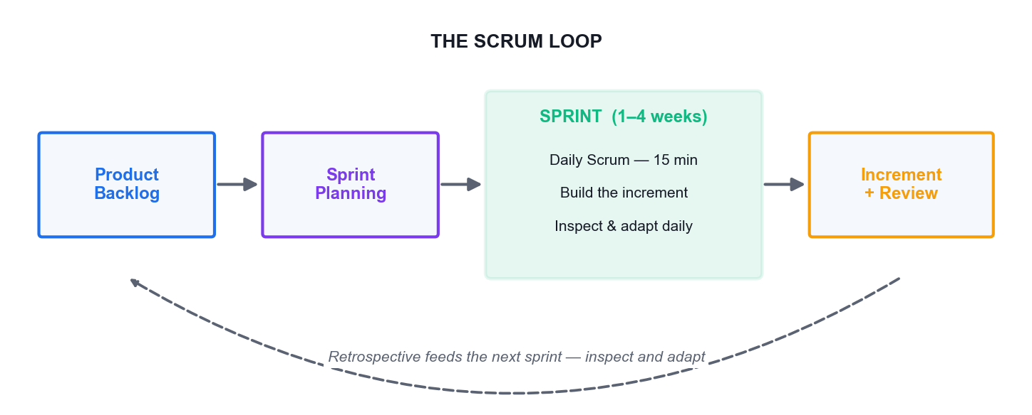
AGILE FRAMEWORKS FOR INNOVATION PROJECTS
The Scrum Loop
Scrum delivers the highest value in the shortest time through transparency, inspection and adaptation.
Fast-Track Innovations with Agile Design Thinking and GenAI · TGS-2024049781
© 2026 Tertiary Infotech Academy Pte Ltd
73

Slide 74
WHO DOES WHAT
The Scrum Team — Three Accountabilities
Product Owner
Owns the product vision and the backlog; the final decision-maker on priority. Owns the WHAT.
Scrum Master
Enables the process, removes impediments, protects the team's focus, coaches the practice.
1
2
Developers
The cross-functional group who build the increment. Self-organising; they own the HOW.
Team size
Small enough to stay coordinated — typically around seven people, plus or minus two.
3
4
Cross-functional
The team contains every skill needed to produce a done increment without external handoff.
Self-managing
The team decides how the work gets done; nobody outside it assigns tasks to individuals.
5
6
Fast-Track Innovations with Agile Design Thinking and GenAI · TGS-2024049781
© 2026 Tertiary Infotech Academy Pte Ltd
74

Slide 75
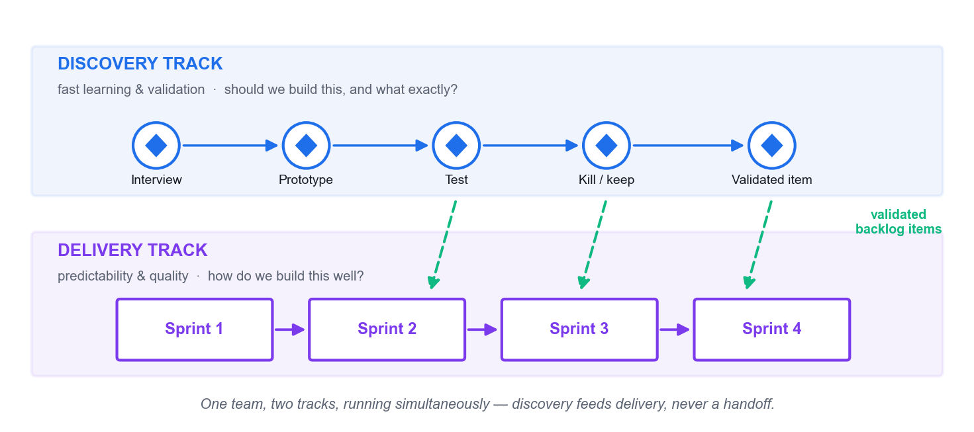
THE OPERATING MODEL OF MODERN PRODUCT TEAMS
Dual-Track Agile — Discovery and Delivery Together
Discovery asks 'should we build this?'; delivery asks 'how do we build it well?' — one team, two tracks, running at once.
Fast-Track Innovations with Agile Design Thinking and GenAI · TGS-2024049781
© 2026 Tertiary Infotech Academy Pte Ltd
75

Slide 76
JEFF PATTON · CORRECTING THE RECORD
Four Myths About Dual-Track
'Discovery comes first, then delivery'
No — both run continuously and simultaneously within the same team.
'Everything flows discovery → delivery'
No — most ideas are changed or killed during discovery. That is the point.
1
2
'They are separate teams'
No — a trio may lead discovery, but the whole team participates in it.
'Discovery ends at launch'
No — keep measuring and learning after you ship; that is when reality arrives.
3
4
Fast-Track Innovations with Agile Design Thinking and GenAI · TGS-2024049781
© 2026 Tertiary Infotech Academy Pte Ltd
76

Slide 77
MARTY CAGAN · THE COMMON ANTI-PATTERN
Beware the mini-waterfall inside your sprint.
PM writes requirements → hands to a designer → hands to the delivery team. Each handoff looks like collaboration and is actually a queue.
Fast-Track Innovations with Agile Design Thinking and GenAI · TGS-2024049781
© 2026 Tertiary Infotech Academy Pte Ltd
77

Slide 78
CONVERTING IDEAS INTO AGILE ARTEFACTS
From Idea to Task — the Decomposition Ladder
Level
What it is
Example
Epic
A large body of work spanning many sprints
Self-service health screening
Feature
A coherent capability within an epic
Appointment booking without a call centre
Hill
An outcome statement: as a [who], I want [what], so that [wow]
As a first-time patient, I can book a screening in under 3 minutes, so that I never need to phone.
User story
A small unit of value: as a [user], I want [goal], so that [reason]
As a patient, I want to see the next three available slots so that I can choose quickly.
Task
The work needed to deliver the story
Build the slot-availability API endpoint.
WHEN IT MATTERS A Hill states the outcome and the 'wow'; a user story states the function. Teach both — they do different jobs.
Fast-Track Innovations with Agile Design Thinking and GenAI · TGS-2024049781
© 2026 Tertiary Infotech Academy Pte Ltd
78

Slide 79
RON JEFFRIES · THE 3 C's
User Stories — the Three C's
Card
The story is written small, on a card. Its size is a deliberate constraint on scope.
Conversation
The card is a promise to have a conversation — the detail lives in the discussion, not the text.
1
2
Confirmation
Acceptance criteria define how you will know it is done. Testable, not restated.
The common failure
Acceptance criteria that merely repeat the story. If it cannot fail a test, it is not a criterion.
3
4
Fast-Track Innovations with Agile Design Thinking and GenAI · TGS-2024049781
© 2026 Tertiary Infotech Academy Pte Ltd
79

Slide 80
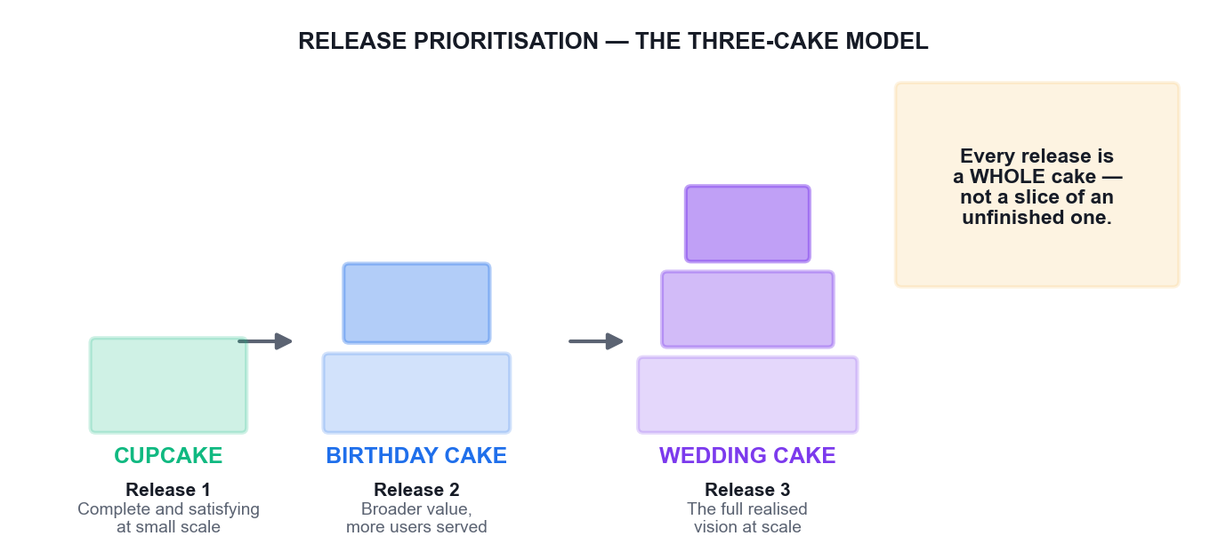
IBM DESIGN THINKING
Release Prioritisation — The Three-Cake Model
Every release must be a whole cake at its own scale. A slice of an unfinished wedding cake is not a smaller product — it is a broken one.
Fast-Track Innovations with Agile Design Thinking and GenAI · TGS-2024049781
© 2026 Tertiary Infotech Academy Pte Ltd
80

Slide 81
ESTIMATION THAT SURVIVES CONTACT
Agile Estimation — Story Points
Size, not duration
Points measure relative complexity and effort, not hours. Duration is derived later from velocity.
Relative, not absolute
Humans compare well and predict poorly — 'this is twice that' beats 'this takes six hours'.
1
2
A constrained scale
Fibonacci-like values (1, 2, 3, 5, 8, 13) force meaningful distinctions between sizes.
Additive
Points can be summed across stories; time-based estimates cannot be summed honestly.
3
4
Velocity from done work
Only fully 'done, done' stories count. Partial credit destroys the signal.
Planning Poker
Estimate privately, reveal together, discuss the outliers — that discussion is the real value.
5
6
Fast-Track Innovations with Agile Design Thinking and GenAI · TGS-2024049781
© 2026 Tertiary Infotech Academy Pte Ltd
81

Slide 82
FASTER ITERATIONS WITHOUT LOSING THE DECISION
GenAI Across the Sprint
Backlog drafting
Generate candidate stories and acceptance criteria from a Hill in seconds — then cut what is unvalidated.
Backlog grooming
Flag duplicates and related items across a large backlog faster than a human scan.
1
2
Test data
Generate realistic edge-case data sets for testing without exposing real customer records.
Retro synthesis
Cluster retrospective themes across many notes — after the team has spoken, never instead of it.
3
4
Sprint reporting
Draft the summary so the Scrum Master spends the time on impediments, not formatting.
Where it must not run
Prioritisation, the disruption decision, and the retrospective conversation itself.
5
6
Fast-Track Innovations with Agile Design Thinking and GenAI · TGS-2024049781
© 2026 Tertiary Infotech Academy Pte Ltd
82

Slide 83
TOPIC 03 · REAL-WORLD CASE STUDY
Spotify — Reading a Scaling Model Honestly
ACTIVITY 7 · 45 MIN
THE REAL CASE
YOUR SCENARIO
In 2012 Henrik Kniberg and Anders Ivarsson published a paper describing how Spotify organised engineering into Squads, Tribes, Chapters and Guilds. It spread worldwide as 'the Spotify Model' and was copied by hundreds of organisations. What most of those organisations missed was the disclaimer in the paper itself: it was a snapshot of a journey, not a framework, and Spotify had already moved on. Kniberg later stated plainly that Spotify does not use 'the Spotify Model' and that people should not copy it. Organisations that copied the structure — renaming teams 'squads' and departments 'tribes' — routinely failed to copy the culture of trust and autonomy that made it work, and ended up with the same hierarchy under new labels. The lesson: practices without principles are a short-lived Band-Aid.
Your management team has returned from a conference and wants to 'implement the Spotify Model' across three departments by the end of the quarter. You have been asked to write the implementation plan.
Full case, discussion questions and debrief: see the Learner Guide and the printed activity brief.
Fast-Track Innovations with Agile Design Thinking and GenAI · TGS-2024049781
© 2026 Tertiary Infotech Academy Pte Ltd
83

Slide 84
ACTIVITY 7 · WORK IN GROUPS OF 3–5
45 MIN
Activity 7 — Discussion Questions
1
Spotify's own authors say do not copy it. Why did hundreds of organisations copy it anyway?
2
Separate the list: which parts of the model are structures (copyable) and which are cultures (not directly copyable)?
3
'Practices without principles are a short-lived Band-Aid. And principles without practices are a fruitless exercise in philosophy.' Give a workplace example of each failure mode.
4
Your management wants it done by Q4. Write the one question that reframes the request without being insubordinate.
5
How might GenAI help you assess organisational readiness before a rollout — and what would it get wrong?
Fast-Track Innovations with Agile Design Thinking and GenAI · TGS-2024049781
© 2026 Tertiary Infotech Academy Pte Ltd
84

Slide 85
ACTIVITY 7 · BRIEF
Activity 7 — What You Produce
1
Your task
Learners examine the most-copied agile scaling model in the industry and diagnose why structural copying fails, then distinguish the transferable principles from the non-transferable artefacts — the core skill in leading design thinking and agile projects across an organisation.
2
You will produce
A Padlet board separating Spotify's transferable principles from its non-transferable structures, and a one-page counter-proposal to the 'implement it by Q4' instruction.
3
Tools
Padlet Classroom Board, ChatGPT or Microsoft Copilot
4
Done when
Your board cleanly separates structure from principle, and your counter-proposal names one team, one outcome and one metric rather than an organisation-wide rollout.
Fast-Track Innovations with Agile Design Thinking and GenAI · TGS-2024049781
© 2026 Tertiary Infotech Academy Pte Ltd
85

Slide 86
ACTIVITY 7 · TRAINER DEBRIEF
Activity 7 — Debrief
WHAT THE ROOM SHOULD CONCLUDE
Renaming a department a 'tribe' changes nothing; devolving budget authority to it changes everything. The copyable parts are the visible artefacts — squad names, chapter structures, guild meetings. The parts that actually generated the results are autonomy backed by real decision rights, alignment through a clear mission, and a tolerance for teams choosing different practices. Those cannot be installed by reorganisation chart. The professional move when handed 'implement it by Q4' is not refusal but reframing: ask what outcome the leadership team actually wants — faster delivery, better retention, fewer handoffs — and then propose the smallest change that could plausibly move it, run in one team first. PremierAgile's guidance applies directly: start small, low-risk and high-value, one to three attempts before scaling.
Fast-Track Innovations with Agile Design Thinking and GenAI · TGS-2024049781
© 2026 Tertiary Infotech Academy Pte Ltd
86

Slide 87
TOPIC 03 · REAL-WORLD CASE STUDY
From Hills to Backlog — Converting Ideas into Stories with GenAI
ACTIVITY 8 · 55 MIN
THE REAL CASE
YOUR SCENARIO
IBM runs a two-day Design Thinking and Agile workshop in which Day 1 produces 'Hills' — outcome statements in the form 'As a [who], I want [what], so that [wow]' — and Day 2 converts them into 20–30 user stories, prioritises them into three releases and sizes them with Planning Poker. In one documented session, a manufacturing user's need for inventory data started as a vague 'in minutes'. The team pushed until it became '5 minutes', and the justification made the requirement real: the data had to be available before the morning manager meeting. That specificity is what separates an outcome you can test from an aspiration you cannot. IBM prioritises releases as 'Cupcake, Birthday Cake, Wedding Cake' — where the cupcake is a complete, satisfying cake at small scale, not a slice of an unfinished one.
Take the prototype concept your group validated in Activity 6. Your product trio — product manager, designer, engineer — now has one hour to turn it into a release-one backlog that a delivery team could actually start on Monday.
Full case, discussion questions and debrief: see the Learner Guide and the printed activity brief.
Fast-Track Innovations with Agile Design Thinking and GenAI · TGS-2024049781
© 2026 Tertiary Infotech Academy Pte Ltd
87

Slide 88
ACTIVITY 8 · WORK IN GROUPS OF 3–5
55 MIN
Activity 8 — Discussion Questions
1
Compare a Hill ('so that [wow]') with a user story ('so that [reason]'). What does the Hill capture that the story loses?
2
The team pushed 'in minutes' to '5 minutes'. What forced the specificity, and what would have happened without it?
3
Review the AI-generated stories. What did it get structurally right, and what did it get wrong about your context?
4
Explain 'Cupcake' to someone who thinks an MVP is 'version one with features removed'. Where is the difference?
5
Story points measure size and complexity, not duration. Why does the distinction matter for a team's velocity?
Fast-Track Innovations with Agile Design Thinking and GenAI · TGS-2024049781
© 2026 Tertiary Infotech Academy Pte Ltd
88

Slide 89
ACTIVITY 8 · BRIEF
Activity 8 — What You Produce
1
Your task
Learners write a measurable Hill, use GenAI to expand it into user stories with acceptance criteria, critique and correct the AI output, prioritise into the three-cake release model and size the stories with relative estimation.
2
You will produce
A prioritised release-one backlog: one Hill, 8–12 user stories with acceptance criteria, a Cupcake/Birthday/Wedding split and story-point estimates.
3
Tools
Design Thinking Studio, Padlet Classroom Board, ChatGPT or Microsoft Copilot
4
Done when
Your Cupcake release is genuinely shippable and useful on its own, every story has testable acceptance criteria, and you can point to which stories you deleted from the AI output and say why.
Fast-Track Innovations with Agile Design Thinking and GenAI · TGS-2024049781
© 2026 Tertiary Infotech Academy Pte Ltd
89

Slide 90
ACTIVITY 8 · TRAINER DEBRIEF
Activity 8 — Debrief
WHAT THE ROOM SHOULD CONCLUDE
GenAI is genuinely good at the mechanical layer of this task — it produces well-formed stories with plausible acceptance criteria in seconds, and it rarely forgets the syntax. What it cannot supply is context: your constraints, your regulatory environment, your legacy integration, your users' actual tolerance for change. The reliable pattern is AI drafts, humans decide. Watch for the two characteristic AI failures in the room: stories that are technically well-formed but describe features nobody validated, and acceptance criteria that restate the story instead of defining a testable condition. On the cake model — the point of the cupcake is that a person could genuinely enjoy it and it stands alone. A slice of unfinished wedding cake is not a smaller product, it is a broken one, and shipping it teaches you nothing except that users dislike broken things.
Fast-Track Innovations with Agile Design Thinking and GenAI · TGS-2024049781
© 2026 Tertiary Infotech Academy Pte Ltd
90

Slide 91
TOPIC 03 · REAL-WORLD CASE STUDY
Running Dual-Track Agile — A Sprint Simulation with AI Assistance
ACTIVITY 9 · 50 MIN
THE REAL CASE
YOUR SCENARIO
Marty Cagan describes the most common failure he sees in teams that believe they are agile: 'many people essentially doing little mini-waterfalls within their Scrum framework' — the product manager writes requirements, hands them to a designer who produces annotated wireframes, who hands them to a delivery team to build and test. Each handoff looks like collaboration and is actually a queue. The dual-track alternative runs discovery and delivery simultaneously in one team: the product trio continuously validates ideas cheaply while the delivery track builds the already-validated ones. Jeff Patton's line is the justification: 'The most expensive way to test your idea is to build production quality software.' Discovery's job is to kill ideas cheaply — 'if we're doing discovery right, we substantially change and kill lots of ideas.'
Your team is running Sprint 1 on the Cupcake release from Activity 8. Mid-sprint, a stakeholder arrives with an urgent new request and a competitor announcement. You must decide what happens to the sprint, the backlog and the discovery track.
Full case, discussion questions and debrief: see the Learner Guide and the printed activity brief.
Fast-Track Innovations with Agile Design Thinking and GenAI · TGS-2024049781
© 2026 Tertiary Infotech Academy Pte Ltd
91

Slide 92
ACTIVITY 9 · WORK IN GROUPS OF 3–5
50 MIN
Activity 9 — Discussion Questions
1
A stakeholder interrupts mid-sprint. What are your options, and what does each one cost in trust, focus and delivery?
2
Cagan calls handoffs 'little mini-waterfalls'. Where do handoffs disguised as collaboration happen in your organisation?
3
Discovery's job is partly to kill ideas. Why is killing an idea a success, and why do organisations rarely reward it?
4
Which ceremony did GenAI genuinely improve, and which one would it damage if you let it run unsupervised?
5
Your velocity drops because the team spent time on discovery. How do you explain that to a manager who only tracks delivery?
Fast-Track Innovations with Agile Design Thinking and GenAI · TGS-2024049781
© 2026 Tertiary Infotech Academy Pte Ltd
92

Slide 93
ACTIVITY 9 · BRIEF
Activity 9 — What You Produce
1
Your task
Learners simulate a compressed sprint — planning, a daily stand-up, a mid-sprint disruption, a review and a retrospective — running a discovery track in parallel, and use GenAI to accelerate the administrative parts of the ceremonies without surrendering the decisions.
2
You will produce
A completed sprint simulation record: sprint goal, committed backlog, stand-up notes, a documented disruption decision, review outcome and an AI-assisted retrospective with three actions.
3
Tools
Padlet Classroom Board, Design Thinking Studio, ChatGPT or Microsoft Copilot
4
Done when
Your sprint record shows a protected sprint goal, a documented and justified disruption decision, and three retrospective actions with named owners.
Fast-Track Innovations with Agile Design Thinking and GenAI · TGS-2024049781
© 2026 Tertiary Infotech Academy Pte Ltd
93

Slide 94
ACTIVITY 9 · TRAINER DEBRIEF
Activity 9 — Debrief
WHAT THE ROOM SHOULD CONCLUDE
The disruption is the real lesson. Teams that protect the sprint goal and route the new request into the discovery track keep both their focus and their responsiveness; teams that swap scope mid-sprint lose the sprint and teach stakeholders that interrupting works. Note the asymmetry — the request does not have to wait long, it just has to be validated before it displaces committed work. On AI in ceremonies: it is excellent at summarising stand-up notes, clustering retrospective themes and drafting the sprint report, and it is actively harmful if it runs the retrospective itself, because the value of a retrospective is the team saying uncomfortable things to each other, not a tidy summary. Watch for velocity anxiety: a team doing genuine discovery will show lower delivery velocity and higher decision quality, which is only a problem if the organisation measures the wrong one.
Fast-Track Innovations with Agile Design Thinking and GenAI · TGS-2024049781
© 2026 Tertiary Infotech Academy Pte Ltd
94

Slide 95
TOPIC RECAP
Recap — Topic 3
• Being Agile is a mindset; doing Agile is the ceremonies — organisations need both to work.
• Scrum's three accountabilities separate the what (PO), the enablement (SM) and the how (Developers).
• Dual-track agile runs discovery and delivery simultaneously in one team, feeding a validated backlog.
• Ideas decompose Epic → Feature → Hill → Story → Task; Hills carry the outcome, stories carry the function.
• Story points measure relative size, and velocity counts only fully completed work.
• GenAI drafts, clusters and summarises — the team still owns every decision.
Fast-Track Innovations with Agile Design Thinking and GenAI · TGS-2024049781
© 2026 Tertiary Infotech Academy Pte Ltd
95

Slide 96
Lunch Break
1 hour

Slide 97
04
TOPIC 04
Scaling and Sustaining Innovations with Agile Design Thinking and Generative AI
Scaling · Stakeholders · Sensemaking · Systems thinking · Resources · Metrics
Fast-Track Innovations with Agile Design Thinking and GenAI · TGS-2024049781
© 2026 Tertiary Infotech Academy Pte Ltd
97

Slide 98
TOPIC 04 · WHY THIS MATTERS
Training 400 people produces 400 people who know the vocabulary.
Scaling innovation is not a training problem — it is a question of what gets measured, who may decide, and what leaders visibly do.
Fast-Track Innovations with Agile Design Thinking and GenAI · TGS-2024049781
© 2026 Tertiary Infotech Academy Pte Ltd
98

Slide 99
THE OPERATING SYSTEM, NOT THE TRAINING CALENDAR
Three Levers That Actually Scale Innovation
Purpose, alignment and autonomy
Be stubborn on the vision and flexible on the details. Teams need a clear outcome and the authority to pursue it.
1
Measure things that matter
Structure metrics around the decisions you intend to make. A metric that cannot change a decision is decoration.
2
Decide from learning
Define beliefs so they can be tested, choose the most important thing to learn, then design the experiment that delivers it.
3
Fast-Track Innovations with Agile Design Thinking and GenAI · TGS-2024049781
© 2026 Tertiary Infotech Academy Pte Ltd
99

Slide 100
STEVE PERKINS · THE DESIGN GYM
Four Principles for a Culture That Sustains It
People over process
Assemble people around a shared mission rather than around a reporting structure.
Creativity and innovation
Build exploration time into the workflow and permit smart risk-taking.
1
2
Iteration and adaptation
Replace year-long plans with low-fidelity versions tested in real conditions.
Multi-disciplinary autonomous teams
Cross-functional teams with genuine local decision authority beat hierarchies.
3
4
Fast-Track Innovations with Agile Design Thinking and GenAI · TGS-2024049781
© 2026 Tertiary Infotech Academy Pte Ltd
100

Slide 101
BUY-IN FOR AI-DRIVEN INNOVATION
Engaging Stakeholders and Creating Buy-In
Start small and visible
Choose a low-risk, high-value opportunity; one credible win buys more permission than any deck.
Bring evidence, not opinion
Show the user quote, the test result and the assumption you falsified.
1
2
Name the metric in advance
Agree what would count as success before you run the pilot, not after.
Involve the sceptic early
The person most likely to block it is the most valuable participant in the discovery.
3
4
Leaders participate, not sponsor
A leader who sits in a user interview changes the organisation's behaviour more than a memo.
Make the risk explicit
State what you will stop doing if the evidence goes against you — it earns credibility.
5
6
Fast-Track Innovations with Agile Design Thinking and GenAI · TGS-2024049781
© 2026 Tertiary Infotech Academy Pte Ltd
101

Slide 102
RESOURCES · GOVERNANCE
Resource Management in Innovation Projects
Fund learning, not plans
Release budget in stages tied to validated learning rather than in one annual block.
Protect discovery capacity
If discovery is unstaffed, delivery will build whatever is loudest.
1
2
Use AI to free expert time
Automate synthesis and drafting so scarce expertise goes to judgement work.
Track the cost of being wrong
The relevant number is not what a test costs, but what building the wrong thing costs.
3
4
Govern AI use
Record provenance, check for bias, and keep an audit trail for AI-assisted decisions.
Kill work deliberately
Stopping a weak initiative releases the scarcest resource you have — your best people.
5
6
Fast-Track Innovations with Agile Design Thinking and GenAI · TGS-2024049781
© 2026 Tertiary Infotech Academy Pte Ltd
102

Slide 103
SENSEMAKING
Sensemaking — Turning Ambiguity into Action
Signals arrive incomplete
Real innovation decisions are made on conflicting, partial and contested evidence.
Build a shared narrative
Sensemaking produces a story the organisation can act on together, not a data dump.
1
2
Name the disconfirming signal
The evidence that contradicts your narrative is the most valuable input in the room.
AI helps, then misleads
GenAI clusters signals well and manufactures a confident narrative even when the evidence is thin.
3
4
Fast-Track Innovations with Agile Design Thinking and GenAI · TGS-2024049781
© 2026 Tertiary Infotech Academy Pte Ltd
103

Slide 104
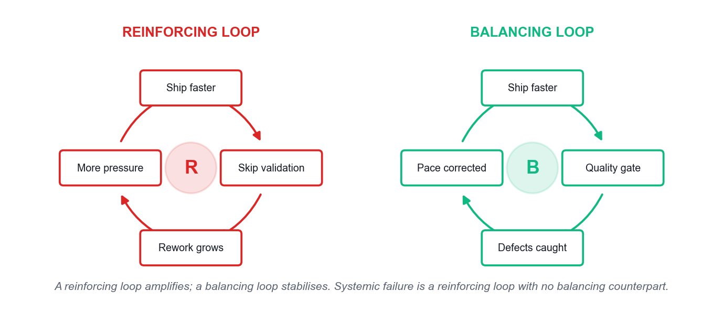
SYSTEMS THINKING
Feedback Loops — Reinforcing and Balancing
Systemic failure is a reinforcing loop with no effective balancing counterpart — no individual decision has to be irrational.
Fast-Track Innovations with Agile Design Thinking and GenAI · TGS-2024049781
© 2026 Tertiary Infotech Academy Pte Ltd
104

Slide 105
SEEING THE WHOLE
The Five Ideas of Systems Thinking
Interconnectedness
Shift from linear cause-and-effect to circular thinking — everything is part of a wider system.
Synthesis
Combine elements to see the whole; analysis alone dissects and loses the behaviour.
1
2
Emergence
System behaviour arises from interaction and cannot be predicted from the parts alone.
Feedback loops
Reinforcing loops amplify; balancing loops stabilise. Find which one you are standing in.
3
4
Causality
Understand how a change in one variable actually propagates to an outcome.
Systems mapping
Draw elements and their interconnections to find the leverage point worth intervening at.
5
6
Fast-Track Innovations with Agile Design Thinking and GenAI · TGS-2024049781
© 2026 Tertiary Infotech Academy Pte Ltd
105

Slide 106
TWO LENSES, ONE PROBLEM
Systems Thinking vs Design Thinking
Design Thinking
Systems Thinking
Starting point
A human need
A pattern of behaviour over time
Unit of attention
The user and their experience
The structure that produces the outcome
Asks
What does this person need?
Why does this system keep producing this result?
Typical output
A validated solution concept
A leverage point and an intervention
Blind spot
Can optimise one user while harming the system
Can map elegantly and never ship anything
Used together
Design the intervention with empathy
Place it where the system will actually respond
WHEN IT MATTERS Use systems thinking to choose where to intervene; use design thinking to design the intervention itself.
Fast-Track Innovations with Agile Design Thinking and GenAI · TGS-2024049781
© 2026 Tertiary Infotech Academy Pte Ltd
106

Slide 107
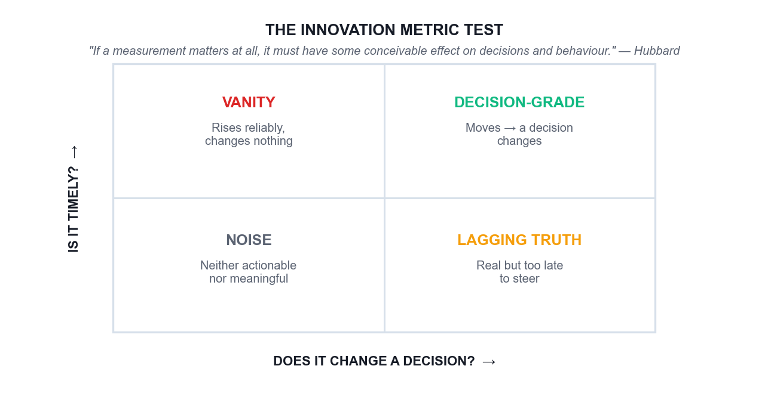
METRICS AND KPIs
The Innovation Metric Test
If a movement in the number would change no decision, the number is decoration — and it will not survive a budget review.
Fast-Track Innovations with Agile Design Thinking and GenAI · TGS-2024049781
© 2026 Tertiary Infotech Academy Pte Ltd
107

Slide 108
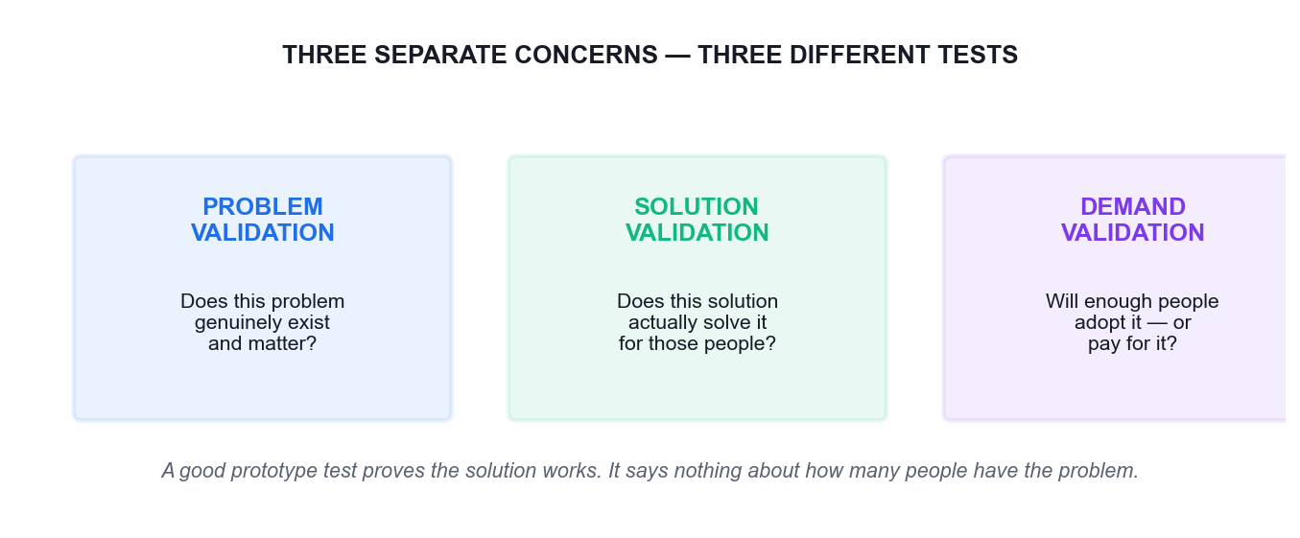
DO NOT CONFLATE THESE
Three Validations, Three Different Tests
Problem validation
Evidence the problem exists and matters to enough people.
Solution validation
Evidence your solution actually solves it for them.
Demand validation
Evidence they will adopt, switch to, or pay for it.
The common error
Presenting solution evidence as if it proved demand — how products launch to silence.
Fast-Track Innovations with Agile Design Thinking and GenAI · TGS-2024049781
© 2026 Tertiary Infotech Academy Pte Ltd
108

Slide 109
WHAT TO PUT ON THE BOARD SLIDE
A Balanced Innovation Scorecard
Customer value
Time saved, effort removed, task success rate, or a genuine satisfaction signal.
Business value
Revenue, cost avoided, retention, or cycle time — expressed in money where honest.
1
2
Societal value
Access, inclusion, safety or environmental effect — the value not captured in the price.
A leading indicator
Something that moves early enough to still change a decision this quarter.
3
4
The decision test
For every metric, write the decision that would change if it moved. No decision, no metric.
Beware vanity metrics
Ideas submitted, workshops run and people trained always rise and prove nothing.
5
6
Fast-Track Innovations with Agile Design Thinking and GenAI · TGS-2024049781
© 2026 Tertiary Infotech Academy Pte Ltd
109

Slide 110
TOPIC 04 · REAL-WORLD CASE STUDY
DBS Bank — Scaling Innovation Across 25,000 People
ACTIVITY 10 · 50 MIN
THE REAL CASE
YOUR SCENARIO
Around 2014 DBS Bank set out to 'Make Banking Joyful' and to become a technology company delivering banking. Rather than launching an innovation lab and hoping it spread, DBS changed the operating system: it ran large-scale hackathons pairing bankers with start-ups, trained thousands of staff in customer journey thinking, moved the majority of its technology in-house from outsourced vendors, and adopted the discipline of measuring customer time saved — reporting tens of millions of customer hours eliminated from waiting and rework. Senior leaders were required to participate, not merely sponsor. DBS was subsequently named the world's best bank by multiple international publications. The instructive part is not the awards but the mechanism: DBS changed what got measured, who had authority, and what leaders personally did — and let the culture follow.
You have run one successful design thinking pilot in your department. Your director is impressed and asks you to 'roll it out to the whole division' — 400 people — with no additional budget and no change to existing KPIs.
Full case, discussion questions and debrief: see the Learner Guide and the printed activity brief.
Fast-Track Innovations with Agile Design Thinking and GenAI · TGS-2024049781
© 2026 Tertiary Infotech Academy Pte Ltd
110

Slide 111
ACTIVITY 10 · WORK IN GROUPS OF 3–5
50 MIN
Activity 10 — Discussion Questions
1
DBS measured 'customer hours saved'. Why is that a more powerful scaling lever than counting how many staff attended training?
2
Your director offers no budget and no KPI change. What is the honest risk to the rollout, and how do you surface it professionally?
3
DBS required leaders to participate rather than sponsor. What is the practical difference, and which does your organisation do?
4
Which is harder to scale — the method, the mindset, or the authority to act on what you learn? Defend your ranking.
5
Where would GenAI genuinely accelerate a 400-person rollout, and where would it create the illusion of progress?
Fast-Track Innovations with Agile Design Thinking and GenAI · TGS-2024049781
© 2026 Tertiary Infotech Academy Pte Ltd
111

Slide 112
ACTIVITY 10 · BRIEF
Activity 10 — What You Produce
1
Your task
Learners analyse how a large regulated organisation actually scaled human-centred innovation, and build a realistic scaling plan that changes measurement, authority and leadership behaviour rather than merely running more training.
2
You will produce
A one-page scaling plan for the learner's own organisation covering the first 90 days, the metric that would change, and the leadership behaviour required.
3
Tools
Padlet Classroom Board, ChatGPT or Microsoft Copilot
4
Done when
Your plan changes at least one measurement and one authority, not just the training calendar, and its scope is small enough to be real.
Fast-Track Innovations with Agile Design Thinking and GenAI · TGS-2024049781
© 2026 Tertiary Infotech Academy Pte Ltd
112

Slide 113
ACTIVITY 10 · TRAINER DEBRIEF
Activity 10 — Debrief
WHAT THE ROOM SHOULD CONCLUDE
Training 400 people produces 400 people who know the vocabulary and cannot use it, unless three other things change: what gets measured, who is allowed to decide, and what senior leaders visibly do. DBS's customer-hours-saved metric is instructive because it is a customer-value measure that the whole organisation could act on, unlike a training-completion count, which measures activity and changes nothing. The honest answer to the no-budget no-KPI-change instruction is that the rollout will produce awareness without behaviour — and the professional way to say so is to propose a smaller scope with a real metric attached rather than to accept an unachievable one. GenAI can genuinely help with scale here: producing training material, synthesising feedback from 400 people, spotting where teams are stuck. It cannot manufacture the authority that makes the method usable.
Fast-Track Innovations with Agile Design Thinking and GenAI · TGS-2024049781
© 2026 Tertiary Infotech Academy Pte Ltd
113

Slide 114
TOPIC 04 · REAL-WORLD CASE STUDY
Boeing 737 MAX — Systems Thinking and the Cost of Local Optimisation
ACTIVITY 11 · 50 MIN
THE REAL CASE
YOUR SCENARIO
Boeing needed a fast, cheap answer to the Airbus A320neo. Fitting larger engines to the existing 737 airframe changed the aircraft's pitch behaviour, so Boeing added MCAS, software that automatically pushed the nose down. Each decision was locally rational: reuse the airframe to save cost and time; solve the aerodynamic consequence in software; keep the aircraft under the same type rating so airlines would not need expensive pilot simulator training; therefore minimise what pilots were told about MCAS. Two crashes killed 346 people and the fleet was grounded worldwide for around 20 months. No single decision was insane in isolation. The system of decisions — commercial pressure, a reused airframe, a software patch, and a training omission driven by the commercial goal — was lethal. This is what a reinforcing feedback loop with no effective balancing loop looks like in practice.
Your organisation is under pressure to ship an AI-assisted feature before a competitor. Each team is optimising its own deliverable. You have been asked to review the programme for systemic risk.
Full case, discussion questions and debrief: see the Learner Guide and the printed activity brief.
Fast-Track Innovations with Agile Design Thinking and GenAI · TGS-2024049781
© 2026 Tertiary Infotech Academy Pte Ltd
114

Slide 115
ACTIVITY 11 · WORK IN GROUPS OF 3–5
50 MIN
Activity 11 — Discussion Questions
1
Trace the chain: which decision made the next one seem necessary? Where could one balancing loop have broken it?
2
Every decision was locally rational. What does that tell you about relying on individual good judgement as a safety mechanism?
3
Who in the system had the information to see the whole picture, and what stopped that information from changing the outcome?
4
Apply the same analysis to an AI-driven innovation programme. Where does speed pressure create a comparable blind spot?
5
What is the systems-thinking equivalent of 'the scanner is too loud' — the local fix that hides the real problem?
Fast-Track Innovations with Agile Design Thinking and GenAI · TGS-2024049781
© 2026 Tertiary Infotech Academy Pte Ltd
115

Slide 116
ACTIVITY 11 · BRIEF
Activity 11 — What You Produce
1
Your task
Learners map a real systemic failure using interconnectedness, feedback loops and causality, then apply the same mapping to an AI-driven innovation programme to identify where local optimisation is producing global risk.
2
You will produce
A causal loop map of the 737 MAX decision chain, and a systemic risk register for the learner's own AI-assisted programme.
3
Tools
Design Thinking Studio, Padlet Classroom Board, ChatGPT or Microsoft Copilot
4
Done when
Your loop map shows causality rather than a timeline, and your risk register names a mechanism with a named owner who has authority to stop work.
Fast-Track Innovations with Agile Design Thinking and GenAI · TGS-2024049781
© 2026 Tertiary Infotech Academy Pte Ltd
116

Slide 117
ACTIVITY 11 · TRAINER DEBRIEF
Activity 11 — Debrief
WHAT THE ROOM SHOULD CONCLUDE
Systems thinking is not an abstract philosophy; it is the discipline that catches failures no individual decision-maker can see. The 737 MAX chain is a textbook reinforcing loop: commercial urgency drove airframe reuse, which drove the software fix, which drove the training omission, each step justified by the previous one, with no balancing loop strong enough to interrupt it. Note who could have interrupted it — regulators, test pilots, engineers — and what neutralised them: delegated certification, schedule pressure, and a framing in which raising the concern meant arguing against the commercial case. For AI programmes the parallel is direct. Speed pressure produces a model shipped without evaluation, then a guardrail bolted on, then a monitoring gap because monitoring would slow the launch. The countermeasure is structural, not attitudinal: a named balancing mechanism with the authority to stop the line.
Fast-Track Innovations with Agile Design Thinking and GenAI · TGS-2024049781
© 2026 Tertiary Infotech Academy Pte Ltd
117

Slide 118
TOPIC 04 · REAL-WORLD CASE STUDY
Innovation Metrics — Designing KPIs That Change a Decision
ACTIVITY 12 · 45 MIN
THE REAL CASE
YOUR SCENARIO
Two innovation programmes reported to the same board. Programme A reported ideas submitted, workshops run, staff trained and prototypes built — all rising quarter on quarter. Programme B reported one number: the change in the time it took a customer to complete an application, and the resulting drop in abandoned applications. When budgets tightened, Programme A could not answer the question 'what decision would we make differently if this number moved?' and was cut. Its metrics measured activity, not consequence. Douglas Hubbard's test is the sharpest available: 'If a measurement matters at all, it is because it must have some conceivable effect on decisions and behaviour.' Thoughtworks adds the distinction most teams miss — validating that a problem is real, that a solution works, and that there is demand for it are three separate concerns needing three different tests.
You must present your innovation programme to a board that is deciding next year's budget. You have one slide and four numbers.
Full case, discussion questions and debrief: see the Learner Guide and the printed activity brief.
Fast-Track Innovations with Agile Design Thinking and GenAI · TGS-2024049781
© 2026 Tertiary Infotech Academy Pte Ltd
118

Slide 119
ACTIVITY 12 · WORK IN GROUPS OF 3–5
45 MIN
Activity 12 — Discussion Questions
1
Apply Hubbard's test to 'number of ideas submitted'. What decision would change if it doubled? If none, why is it still so popular?
2
Separate problem validation, solution validation and demand validation. Give one test for each for your own concept.
3
Which is harder to measure — customer value, business value or societal value — and what happens when you only measure the easy one?
4
Your board wants a single number. What do you lose by giving them one, and how do you manage that?
5
How could GenAI help build this scorecard, and how could it help you fool yourself with it?
Fast-Track Innovations with Agile Design Thinking and GenAI · TGS-2024049781
© 2026 Tertiary Infotech Academy Pte Ltd
119

Slide 120
ACTIVITY 12 · BRIEF
Activity 12 — What You Produce
1
Your task
Learners audit vanity metrics against Hubbard's decision test, build a balanced measurement set spanning customer, business and societal value, and separate problem, solution and demand validation.
2
You will produce
A four-metric innovation scorecard where every metric passes the decision test, plus a stated validation plan distinguishing problem, solution and demand.
3
Tools
Padlet Classroom Board, ChatGPT or Microsoft Copilot
4
Done when
Every metric on your scorecard has a stated decision attached to it, and your three validation tests are genuinely different tests rather than three versions of the same one.
Fast-Track Innovations with Agile Design Thinking and GenAI · TGS-2024049781
© 2026 Tertiary Infotech Academy Pte Ltd
120

Slide 121
ACTIVITY 12 · TRAINER DEBRIEF
Activity 12 — Debrief
WHAT THE ROOM SHOULD CONCLUDE
Almost every group's first draft contains at least one activity metric — ideas submitted, workshops run, people trained — because they are easy to collect and always go up. Hubbard's test kills them on contact: if no plausible movement in the number would change any decision, the number is decoration and it will not survive a budget review. The three-validation split is the other common gap: a successful prototype test proves the solution works for people who already have the problem, and says nothing about how many people have it or whether they will pay. Teams routinely present solution-validation evidence as if it were demand evidence, which is how confidently-built products launch to silence. On GenAI: it will happily generate a plausible, well-formatted scorecard in seconds, and that fluency is precisely the risk — a metric set that looks professional and measures nothing consequential is harder to challenge than an obviously bad one.
Fast-Track Innovations with Agile Design Thinking and GenAI · TGS-2024049781
© 2026 Tertiary Infotech Academy Pte Ltd
121

Slide 122
TOPIC RECAP
Recap — Topic 4
• Scaling changes the operating system: what is measured, who decides, and what leaders actually do.
• Buy-in is earned with a small visible win and evidence, not with a persuasive deck.
• Sensemaking builds a shared narrative from conflicting signals — and AI can manufacture false confidence.
• Systems thinking finds the leverage point; design thinking designs the intervention that goes there.
• Every metric must have a decision attached to it, or it is decoration.
• Problem, solution and demand validation are three separate tests — never present one as another.
Fast-Track Innovations with Agile Design Thinking and GenAI · TGS-2024049781
© 2026 Tertiary Infotech Academy Pte Ltd
122

Slide 123
WRAP-UP
Course Summary & Next Steps
Fast-Track Innovations with Agile Design Thinking and GenAI · TGS-2024049781
© 2026 Tertiary Infotech Academy Pte Ltd
123

Slide 124
LEARNING OUTCOMES
What You Achieved
LO1 · Integrated DT, Agile and GenAI
You positioned design thinking, lean and agile against each other and placed GenAI correctly inside the loop.
LO2 · Synthesised stakeholder inputs
You built empathy maps, POV statements and How Might We questions from real case evidence.
1
2
LO3 · Led design thinking projects
You ran dual-track discovery, converted Hills into a sized backlog and managed a sprint disruption.
LO4 · Developed agile DT strategies
You built a scaling plan, mapped systemic risk and designed a metric set that changes decisions.
3
4
Fast-Track Innovations with Agile Design Thinking and GenAI · TGS-2024049781
© 2026 Tertiary Infotech Academy Pte Ltd
124

Slide 125
NEXT STEPS
Take This Back to Work on Monday
Reframe one brief
Take one current requirement and rewrite it as a POV and a How Might We question.
Run one cheap test
Pick your riskiest assumption and design the cheapest test that could disprove it.
1
2
Audit one metric
Apply the decision test to your team's favourite number. Be honest about the result.
Start one discovery track
Give one team two hours a week of protected discovery time and see what changes.
3
4
Label your AI output
Mark every AI-generated persona or insight as unvalidated until evidence confirms it.
Find one balancing loop
Identify a reinforcing loop in your organisation that has no counterweight — and propose one.
5
6
Fast-Track Innovations with Agile Design Thinking and GenAI · TGS-2024049781
© 2026 Tertiary Infotech Academy Pte Ltd
125

Slide 126
GO DEEPER
Continue Your Learning
Design Thinking Studio
https://alfredang.github.io/designthinking/ — keep using the workspace with your own team.
Padlet Classroom Board
https://alfredang.github.io/padlet/ — run your own retrospectives and idea boards.
1
2
Thoughtworks on DT, Lean and Agile
Jonny Schneider on how the three mindsets work together.
Marty Cagan & Jeff Patton
Dual-track agile, continuous discovery and the product trio.
3
4
Rittel & Webber (1973)
The original paper on wicked problems and why framing precedes solving.
Tertiary Infotech course catalogue
www.tertiarycourses.com.sg — further WSQ courses in AI and innovation.
5
6
Fast-Track Innovations with Agile Design Thinking and GenAI · TGS-2024049781
© 2026 Tertiary Infotech Academy Pte Ltd
126

Slide 127
WE'RE HERE TO HELP
Support
• If you have any enquiries during or after the class, you can contact us below.
• Email: enquiry@tertiaryinfotech.com
• Tel: +65 6100 0613
• Website: www.tertiarycourses.com.sg
• LMS / TMS: https://lms-tms.tertiaryinfotech.com
Fast-Track Innovations with Agile Design Thinking and GenAI · TGS-2024049781
© 2026 Tertiary Infotech Academy Pte Ltd
127

Slide 128
WRAP-UP
Assessment
Written Assessment (SAQ)
0.5 hour · open book · short-answer questions on the underpinning knowledge.
Case Study (CS)
1 hour · open book · a scenario-based innovation case across all four topics.
1
2
Digital attendance
Remember to take the Assessment digital attendance (TRAQOM) before you start.
Submit on the LMS
Upload your completed answers at https://lms-tms.tertiaryinfotech.com/
3
4
Fast-Track Innovations with Agile Design Thinking and GenAI · TGS-2024049781
© 2026 Tertiary Infotech Academy Pte Ltd
128

Slide 129
ON ASSESSMENT DAY
Assessment Flow
1
2
3
4
5
TRAQOM survey
Digital attendance
Sit WA then CS
Submit on the LMS
Sign the record
Scan the QR code on the LMS
Scan the SSG assessment QR
WA 0.5 h then CS 1 h · open book
Upload your completed answers
Sign the Assessment Summary Record
REMEMBER
All five steps are mandatory for WSQ funding — missing the digital attendance or the TRAQOM survey can invalidate your claim.
Fast-Track Innovations with Agile Design Thinking and GenAI · TGS-2024049781
© 2026 Tertiary Infotech Academy Pte Ltd
129

Slide 130
TRAQOM · SSG DIGITAL ATTENDANCE
Digital Attendance (Mandatory)
Three times a day
Take the AM, PM and Assessment digital attendance — mandatory for every WSQ-funded course.
Trainer shows the QR
The trainer or administrator displays the digital attendance QR code from the SSG portal.
1
2
Scan and submit
Scan the QR code with your mobile phone camera and submit your attendance.
75% minimum
A minimum of 75% attendance is required to be eligible for assessment and funding.
3
4
Fast-Track Innovations with Agile Design Thinking and GenAI · TGS-2024049781
© 2026 Tertiary Infotech Academy Pte Ltd
130

Slide 131
END OF COURSE
Thank You!
You can now frame the right problem, validate it cheaply, deliver it with agile discipline, and scale it without losing the evidence.
Fast-Track Innovations with Agile Design Thinking and GenAI · TGS-2024049781
© 2026 Tertiary Infotech Academy Pte Ltd
131

